Slide 1
Using Google Drive for Volleyball Team Management
Kayla Ruff

Slide 2
Benefits
Fast and efficient
Everyone has access to it
Communication is easy and direct
Edits can be made fast and from anyone, anywhere, at any time
Environmental friendly- instead of using paper and pencil for many of the documents

Slide 3
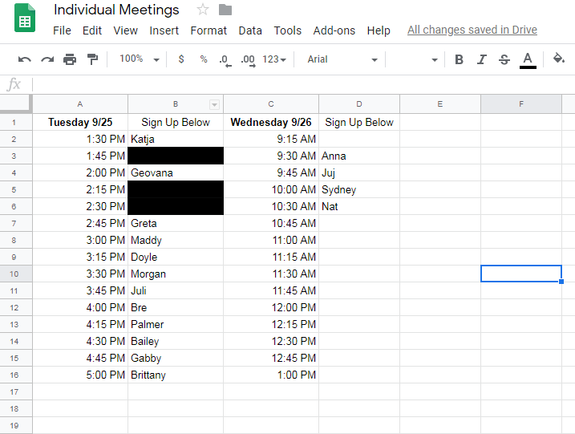
Meeting Sign-Ups
We use Google Sheets when scheduling meetings and other sign-up necessities.
If we didn’t have this, we would probably hang a paper sign-up sheet on one of our doors.

Slide 4
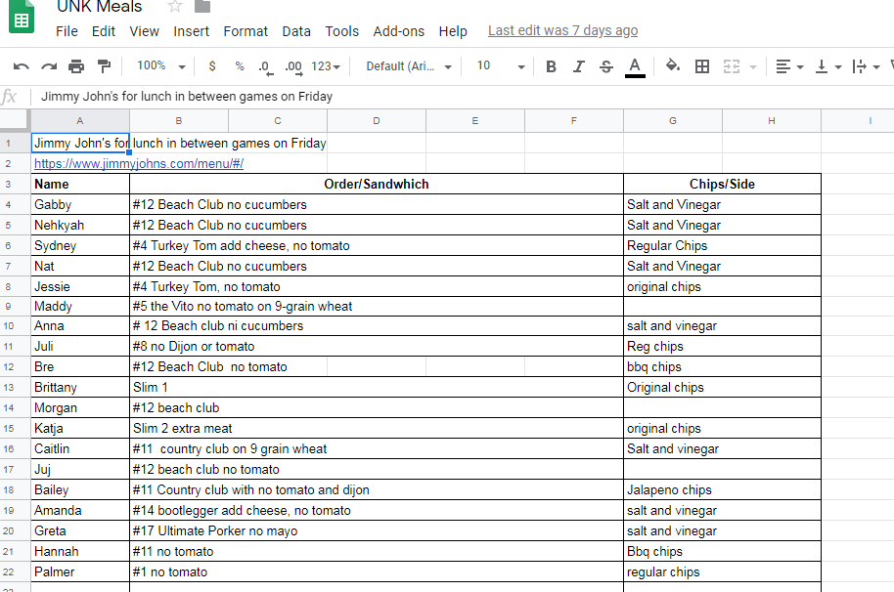
Team Meals
This is has been the best use of google sheets for me. I am in charge of meals when we travel. Having google sheets makes me life easier when figuring out meal orders. The girls enjoy the ease of this as well.

Slide 5
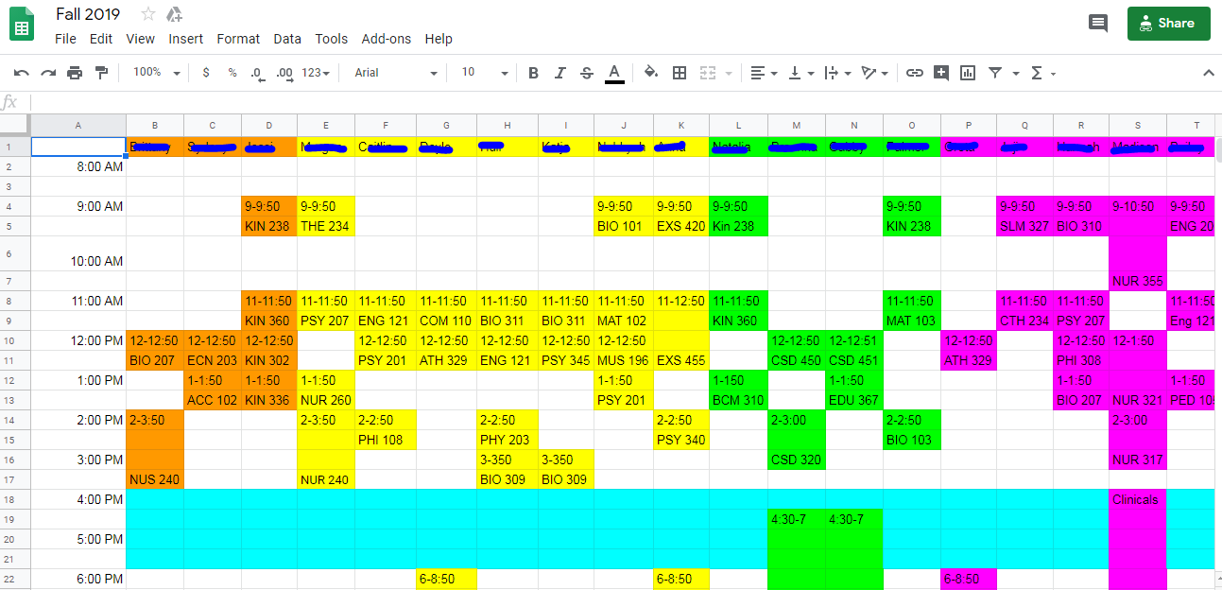
Player Schedules
This has been a life-saver as well. We are able to have all of the player’s schedules for each day in one place. This way all the coaches have access to it and can edit it at any time.

Slide 6
SAMR Model Augmentation
Google Drive to me is on the Augmentation level. It acts as more of a direct tool substitute with some functional change. Google Excel and how we are using it, is replacing more of those paper and pen type stuff, and allowing multiple people to write in a document at one time from anywhere. It not only makes things faster and more efficient, but it can also be used to give feedback in documents and interact/communicate with people through the internet.

