Slide 1
Teaching the precepts of the Catholic church
I am a Jr. High Religion teacher at a Catholic School
Not all my students are Catholic but over 95% are
I am always trying to find ways to help the students live out their Catholic Faith
The precepts are minimum requirements that all Catholics should follow
I am aware that many Catholics do not follow the Precepts of the Church but I make use of a website an app that helps them to fulfill the precepts
I am also aware that students usually need the support of their parents to fulfill some of the precepts

Slide 2
Teaching the precepts of the Catholic church
Content
-With every lesson there is content that the teacher is trying to teach
The Precepts of the Church:
1. You shall attend Mass on Sundays and holy days of obligation and rest from servile labor.
2. You shall confess your sins at least once a year.
3. You shall receive the sacrament of the Eucharist at least during the Easter season.
4. You shall observe the days of fasting and abstinence established by the Church.
5. You shall help to provide for the needs of the Church.

Slide 3
Teaching the precepts of the Catholic church
Pedagogy (a few examples)
-I use stories and examples to emphasize the importance of the precepts
-I help the students to understand that everything comes from God and what he asks back pales in comparison to what we have received
-Cross curricular learning (a little). I present a fraction to the students 1/168. What if someone was going to give you a business or a large sum of money but all they asked for in return was 1/168 back aka they would want back 0.00595238 or just over one half of one percent would you take that deal? Our Sunday obligation is about one hour of the 168 hours in a week. This should be the first thing on our calendar every week and everything else should revolve around this.
-Think about what we owe to our parents? We would not have life without them, not to mention all they provided for us through the years: love, food, clothes, shelter, rides, and on and on and on. If this is true regarding our parents then what do we owe to God…it is exponentially greater! We use the gifts and talents of God to live our lives! So when we use this gifts to be gainfully employed, what percentage of our paycheck comes from God? What could we have done without him? We may have worked hard, but we worked with everything he gave us. 100% of our paycheck is essentially God’s. So if we give back 10% to the Church and get to keep 90% of God’s money…that is a pretty good deal!

Slide 4
Teaching the precepts of the Catholic church
Technology
-Technology helps to live out some of the precepts and answer objections.
-Most areas in the United States there are multiple Catholic Churches
-There is usually multiple times someone could go to Mass in multiple locations
-Most Catholics have their own parish where they regularly attend
--Objections:
---I have a soccer tournament this weekend and can’t go to mass at the regular time and location
---I have a soccer tournament in a different city and don’t know where a church is
---We are going to Mexico, (France, Japan, etc.) for vacation and I don’t know where the Catholic church is
---I want to go to confession but our parish only offers it on Saturdays from 3-4 PM and Tuesdays from 5-6 PM and I am unavailable at those times

Slide 5
Technology in use: Masstimes.org

Slide 6
Masstimes.org
-Now a student can enter a zip code, state, or any city in the whole world and discover every church near by and their Mass times
-It also provides how far away the church is.
-This improves on the days when someone had to look up a church in the phone book or drive up to one you noticed and check the mass times. Or search the web by city name and “Catholic church”
-No matter where the soccer tournament is in the whole world you are covered.
-Oh wait….there is more…

Slide 7
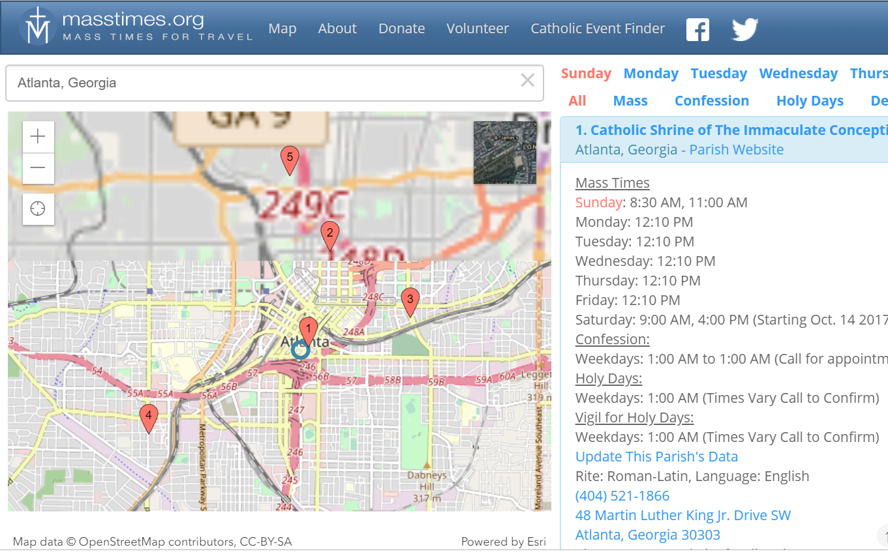
Let’s Imagine a Student is going to Atlanta, Georgia with their family for a week for a tournament
-The image on the left shows the churches in Atlanta on the map
-There is a scroll down on the right for the Churches-near to far by distance
-It also lists the daily mass times and confession times
-But wait, there is more…

Slide 8
Now lets say the family used the site to go to the nearest church on Sunday
-Today is now Tuesday and the child wants to go to confession but they realized that the church they went to on Sunday did not offer it on Tuesdays
-The screen shot here shows that Tuesday and Confession have been clicked at the top right
-This brings up all the churches in the area that offer confession on Tuesdays!
-Oh Wait…there is more…

Slide 9
There is also an app which is very similar
-It gives the mass and confession times
-This can use the GPS on a phone or other device to give turn by turn navigation to the church
Technology can allow for a redefinition for the task of following the Precepts of the Church!

