Slide 1
Swivl
Danielle Sloan

Slide 2
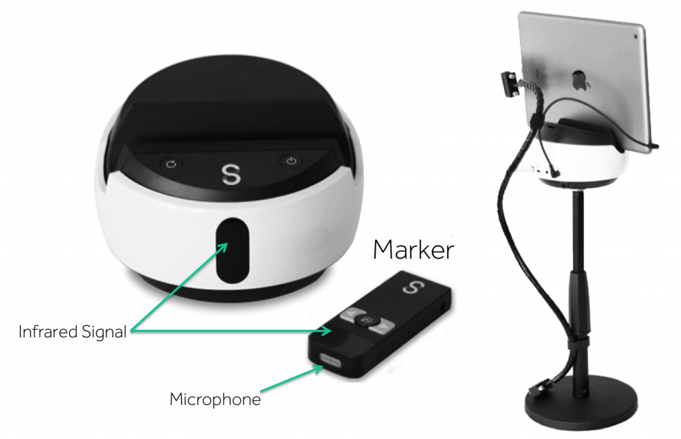
What is swivl?
It is a robotic mount for an Ipad, camera, or smartphone that comes with a remote control Marker.
It is designed to track and record videos of a moving person.
It focuses on whoever holds the marker.
It has 360 degree motion and can tilt 20 degrees.

Slide 3
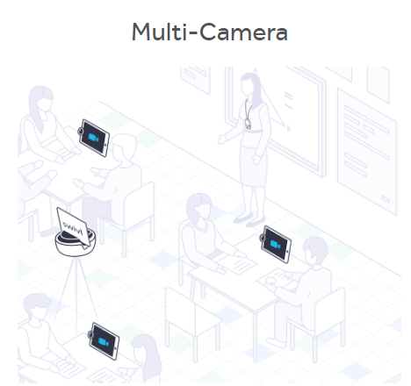
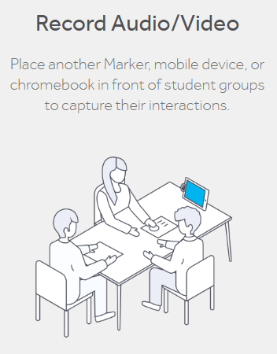
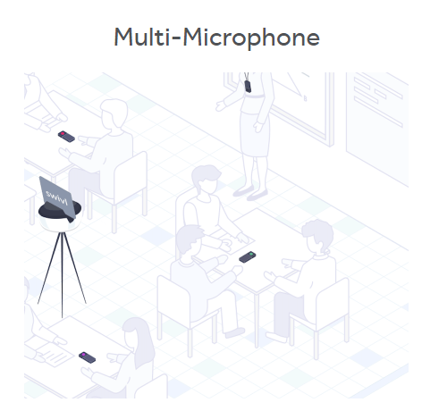
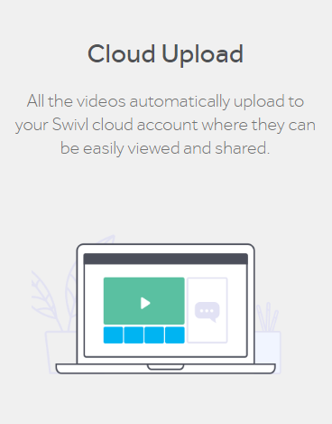

Slide 4
Presentations
Student Oriented
Enhance student learning/projects through creativity and Swivl recordings- the possibilities are endless!
Record group projects that can be shared with peers.
Modifications for students on IEP’s- students present/record with a teacher they are comfortable with and share with grading teacher.
Record projects that can be shared with the community!
Students can use recordings to assist in studying.
Allows students to keep up with the course from any location that has Wi-Fi.
Students can engage in communication with teacher and peers the apps that go with Swivl.
Teacher Oriented
Teachers can pre-record videos for days they are absent.
Teachers can record lectures and upload them for students who were absent – this way students never miss a beat!
Distance learning opportunities.
Pre-record science labs that students can watch while completing the lab to ensure they are completing it properly.
Professional development opportunities- enhance teaching ability through video and ability to share with other colleagues.
Limitless opportunities with the use of video and communication capabilities.

Slide 5
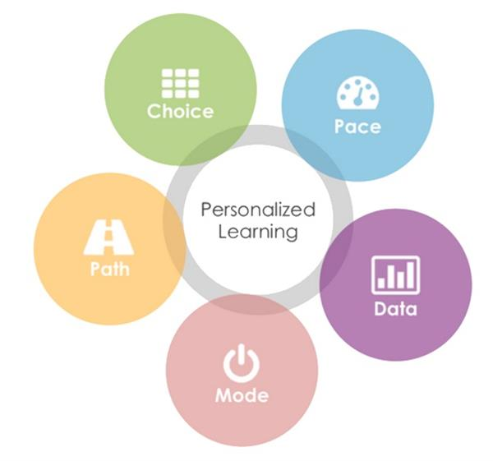
Swivl & Personalized Learning
Pre-record videos that meets the needs of all students.
Create Individualized Education Plans for every student through pre-recorded videos of teacher and peers.
Students get to work at their own pace, with increased teacher availability due to pre-recordings.
Upload, annotate, and dialogue with students.
Students can access information from anywhere!
Use swivl to assess and evaluate students in a diverse way.

Slide 6
Youtube Tutorials
https://www.youtube.com/watch?v=8VXDL4GKQvY
https://www.youtube.com/watch?v=nUCtB9h2Dzc
https://www.youtube.com/watch?v=SfQFNfnGWU0

