Slide 1
SECONDS H.I.I.T. App.
Incorporating Technology into my P.E. Classes

Slide 2
Seconds H.i.i.t. App
Seconds High Intensity Interval Training (HIIT) App
This is an app that I use on my iPad both in my Physical Education classes as well as during wrestling practices.
The app allows me to plan out different warm-ups, workouts, or drills and helps me to stick to a strict schedule.
The app. Allows me to sync my iTunes library to the workouts to enjoy music in the background during the workouts or drills.
The app. Does come as a free version, however I have upgraded to the pro version which allows me to save more customized workouts. The free app. Limits the number of workouts

Slide 3
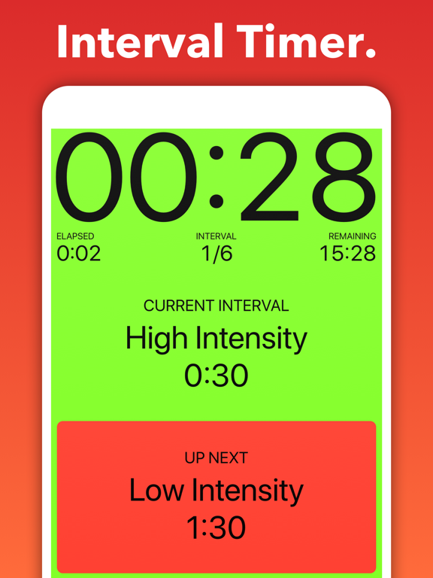
SECONDS HIIT APP
The interval timer is customizable. You can change the times and the names of the intervals.
An example- I use this app during a basketball unit. We may shoot free throws for 2 minutes, then it switches to 3-pointers for 2 minutes, followed by lay-ups for 2 minutes.
I use this during our warm-ups for class a lot as well. I program it for 15-20 seconds of different stretches or movements such as Jogging, skipping, lunges, Karaoka, side shuffles, and sprinting.

Slide 4
SECONDS HIIT APP
I hook my iPad up to the gym speakers and the Seconds APP uses text-to-speech to count down the last 3 seconds of each exercise or drill and then announces the name of the next drill.
The app can also be programmed to play a music playlist from your iTunes library. The music can be programmed to play continuously, or it will change songs each time a new exercise or drill is started.
I also like to use my Apple TV to mirror my iPad on the 70” TV monitor that we have in our wrestling room when we use this app for wrestling workouts. The wrestlers can look at the monitor to see exactly what exercise they should be doing or move they should be drilling. It tells them when to take turns doing the moves and how much time they have left for the drill.

Slide 5
SECONDS HIIT APP.
The free app. Allows you to program a couple of different workouts, the Pro-App allows unlimited different customized timers to be set.

Slide 6
SECONDS HIIT APP
The link below shows a tutorial with an overview about how this app can be used:
https://youtu.be/APvOAV5loJw

Slide 7
SECONDS HIIT APP
SAMR LEVEL- Augmentation
The Seconds HIIT App. Would fall under the augmentation level of the SAMR Model.
As a teacher/coach I can use this app as a substitute for my stopwatch and a list of exercises that I would have.
It allows me to be more focused on observing my students/athletes so I can intervene and help them with the skills when necessary instead of being focused on watching my stop-watch so I know when to blow the whistle and start a new drill/exercise.
I like this tool because the students who are doing well can continue to move along in the progression of the workout by following the app. Even if I am working with a student/athlete one-on-one to help them master the skill that is being worked on.

