Slide 1
Module 2
SAMR Model: Google Classroom

Slide 2
Google Classroom
SAMR
Google classroom has so many unique functions that I believe it hits all four areas of this model.
Why?
This FREE service provided by Google was the most life changing tool that I was ever presented in my eleven years teaching.
After one year I could not even remember how I taught without using Google Classroom.
Problems?
Students need access to a computer.
We are a one to one Chromebook school.

Slide 3
Classroom (Home Page)
This is the page that will show all of the classes you have set up.
Features
It is easy to see what is due for the teacher & student.
I called it an online student planner.
Can be used for extra-curricular activities as well.
I used Classroom to communicate with my basketball team and student organization.
Eliminates the need for texting.

Slide 4
Classroom (Home Page)
Adding a class
Upper right corner…
Click the + symbol, type in your class name, submit.
You can personalize each class with different pictures and text.
Adding students
EASY
Send email invites.
Give them the classroom code.
SCREEN SHOT: NEXT PAGE

Slide 5
Classroom (Home Page)

Slide 6
Classroom (Stream)
Similar too the live feed in Facebook.
It will show…
Announcements, discussions, assignments, quizzes, tests, etc.
In chronological order.
Extremely easy to start class discussions.
I would have an introduction question for students to answer as they entered class and would always have an exit ticket question at the end.
SCREEN SHOT: NEXT PAGE
.

Slide 7
Classroom (Stream)

Slide 8
Classroom (Classwork)
In this section you will see…
Every assignment, quiz, or test you have assigned.
It is a very nice way to stay organized. You see what you have assigned, when it is due, and by clicking on the assignment can see…
What students have completed it, what students have not, and which assignments you have corrected.
You will not see…
Announcement posts.
SCREEN SHOT: NEXT PAGE

Slide 9
Classroom (Classwork)

Slide 10
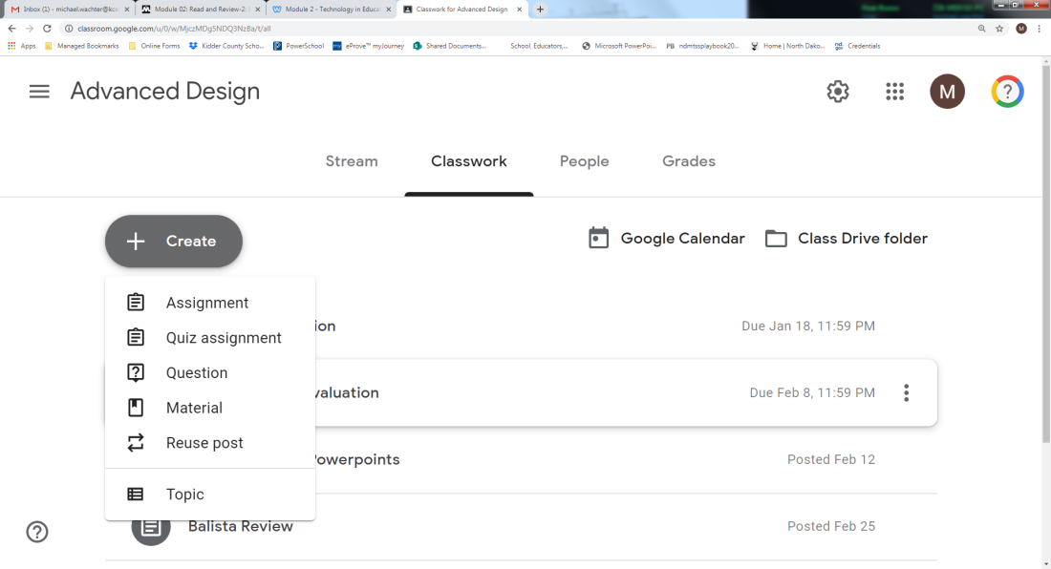
Classroom (Classwork)
This is also where you would create…
1. Assignments
2. Quiz assignments
3. Questions
4. Or reuse posts from the past.
Just click the create button.

Slide 11
Classroom (People)
In the People section…
You see every student in that particular class.
You have instant access to
Email students individually, all at once, or in groups.
Message students
Remove students
Can also add parents to the account.
By adding a parent email they can receive weekly updates and can be just as easy to contact as the students.
I never actually used this feature but it could be beneficial.
SCREEN SHOT: NEXT PAGE

Slide 12
Classroom (People)

Slide 13
Classroom (Grades)
This section is basically an online gradebook.
Every assignment you have graded will show up here.
You can easily print spreadsheets or export directly to PowerSchool.
This would be a substitution for an online gradebook that you most likely already have so it probably will be the least used.
WHY GRADE THINGS IN CLASSROOM
It will send instant feedback directly to the individual student.
You do not have to collect papers/assignments/etc.
I can make corrections in their papers and record comments to individual students or the class as a whole.
SCREEN SHOT: NEXT PAGE

Slide 14
Classroom (Grades)

Slide 15
Classroom (Adding Videos)
YOUTUBE
It rocks because…
You can find videos to relate to almost any subject known to man.
It is easy to access and FREE.
The thing I hate about it…
It is DISTRACTING!!!
One minute I am watching a video on trebuchets the next I am watching a squirrel water skiing.
When you add videos to the live feed student ONLY see the video and nothing else.
They cannot click on the next video or anything else that pops up.
SCREEN SHOT: NEXT TWO PAGES

Slide 16
Classroom (Adding Videos)

Slide 17
Classroom (Adding Videos)
This is what the students see when they click on the video…

Slide 18
Classroom (Assignments)
Assignments
Easy to create.
Easy to store.
Easy to assign.
You can attach…
Videos, documents, pictures, etc.
Easy to see…
Which students have completed their work and WHEN!
When students submit an assignment it records the exact time.
SCREEN SHOT: NEXT TWO PAGES

Slide 19
Classroom (Assignments)

Slide 20
Classroom (Assignments)

Slide 21
SAMR Model
I believe that Google Classroom hits everyone one of these categories. Some of the functions are simple a substitution but there are others that redefine the way education is done today.
If your students have access to a computer daily I highly recommend using this FREE feature. It is amazing what Google has done with this program.

