Slide 1
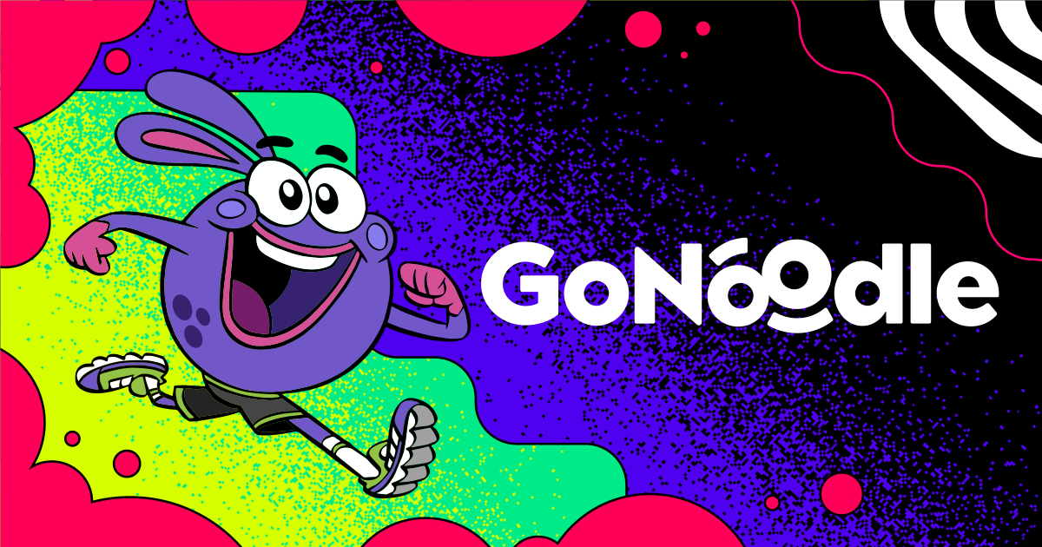
SAMR Assignment
Get Moving!
Katelyn Bradford

Slide 2
What is GoNoodle?
Short interactive videos designed for K-5 students.
GoNoodle gets students moving in their classrooms and at home.
GoNoodle can be easily accessed at gonoodle.com and also through the GoNoodle app.

Slide 3
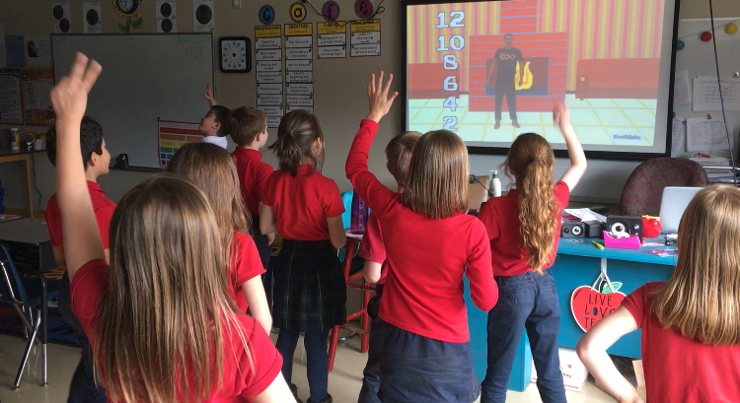
Key Features

Slide 4
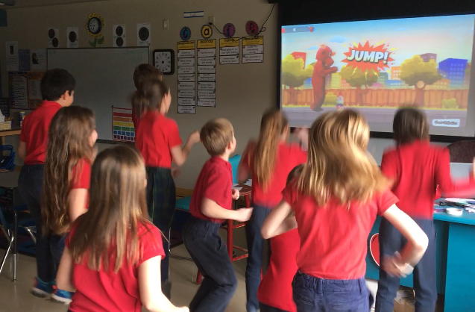
What’s Required?
Free Account
Computer
Internet Connection
Screen

Slide 5
What do I use GoNoodle for?

Slide 6
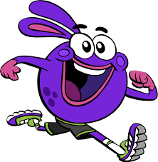
What are students saying about GoNoodle?
(Click on picture after first video is finished playing.)

Slide 7
SAMR Model
I feel like GoNoodle would fall under the Redefinition section of the SAMR Model. I say this because I feel like GoNoodle has redefined what is possible for student movement in the classroom. Before GoNoodle, I would have my students get out of their seats and do things like jumping jacks and squats for brain breaks. I would also have my students do things like puzzles and read books for indoor recess. With GoNoodle, my students are able to get out of their seats and be active for things like brain breaks and indoor recess, while actually enjoying the activities that they are doing.
I also think it falls under the Redefinition section because students are able make curricular connections and learn while moving. The curricular categories on GoNoodle include math, science, ELA, social studies, health, music, reading practice, and Spanish. A few of the videos that I found beneficial for my 2nd graders include skip counting, money and syllables.

Slide 8
Thank You!
APRIL HANSSON

