Slide 1
SAMR Model
Random student generator
Weylin Wahlstrom

Slide 2
Random student generator
Easy to use for:
Calling on random students
Partner collaboration
Teams
Group work or study
Small group
Class roster

Slide 3
3 Easy steps
Add your class names
Select groups
Students find groups

Slide 4
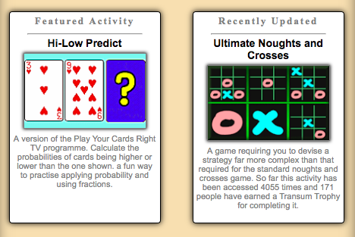
Great Cost
Its free to use!!!
Some adds
Optional add-ons

Slide 5
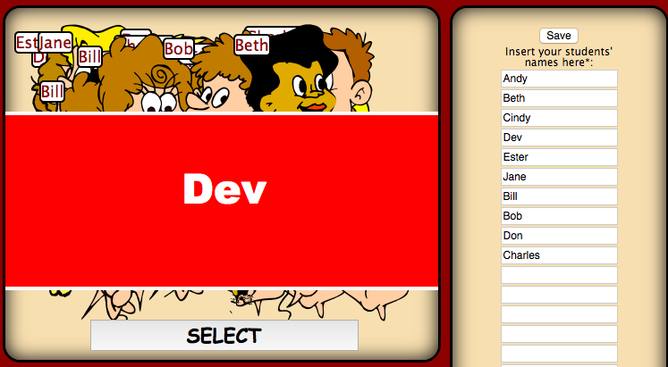
Why random student generator
Save time
Easy to use
Students stay on task
Student collaboration
Lots of options
fun!

Slide 6
CHECK IT OUT !!!
@
http://www.transum.org/software/RandomStudents/

