Slide 1
Quizlet & Quizlet Live
-Learning Vocabulary in the 21st Century
Nick Corbit

Slide 2
Why use Quizlet?
Students are able to enter important vocabulary words or concepts into Quizlet to create an online library of terms.
Students are able to review by themselves whenever they want to.
Students can build on their lists that they create.
There are multiple ways for students to study the terms they put into Quizlet.
Students are able to share their lists with other students.

Slide 3
Overview & Functions
Quizlet is a tool for students to review vocabulary and concepts.
Although many teachers use Quizlet, a lot of teachers may not be using all the functions to get the most out of Quizlet.
Functions of Quizlet
STUDY Functions: | PLAY Functions:
Flashcards (Self Study Format) | Match (Individual Matching Game)
Learn (Study Format working on Mastery | Gravity (Individual Review Game)
Write (Recalling Answer From Memory) | Live (Collaborative Review Game)
Spell (Spelling the Correct Answer)
Test (Test Generator based on List)

Slide 4
How I Use Quizlet
In my 6th grade Language Arts class, we do a vocabulary comprehension activity throughout the year that we call Tuesday/Thursday Vocabulary.
Each week students get three new vocabulary words that they must enter into their personal Quizlet accounts on their computers.
We go over the new words of the week on Tuesdays, and review the entire list that we build throughout the year on Thursdays.
On Thursdays, students always ask if we can review with Quizlet Live. I will briefly explain this function of Quizlet on the next slides.

Slide 5
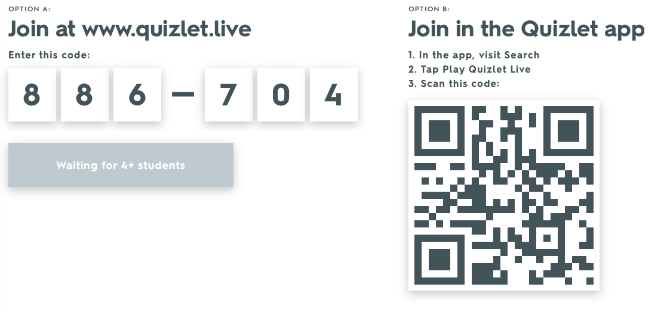
Quizlet Live
Goal: Work with your team to answer all 12 questions correctly.
The same question pops up on all of the teammates’ computers, and they must click the right answer on their computers.
Each player on a team does NOT have the same answers to choose from. It is important to work quickly & accurately!
To start the game, the students enter the code that appears & enter their names.
An end of game summary can be emailed to the teacher to share the most commonly missed questions and data from the game!

Slide 6
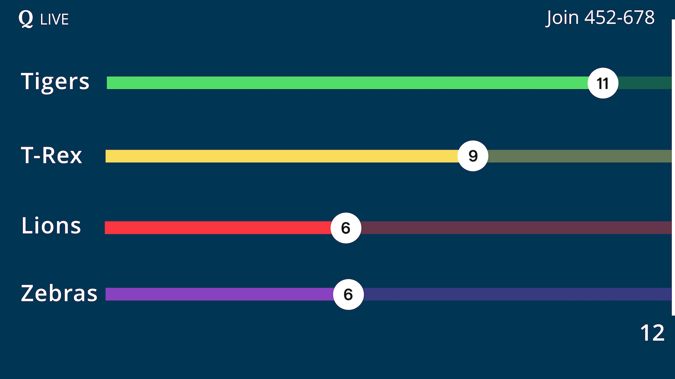
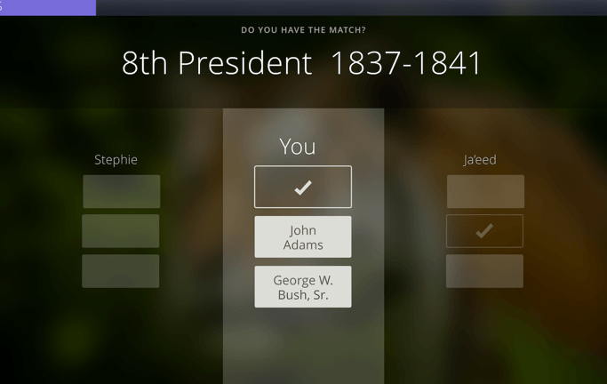
A Quizlet Live Game in Progress
A Student’s Screen During a Game

Slide 7
Quizlet & Quizlet Live on the SAMR Model
I find that just the concept of Quizlet would fall in the Augmentation section of the SAMR Model. We are using Quizlet as a direct tool that is a big improvement from how digital notes are recorded in classrooms.
However, I think that when the Quizlet Live function of Quizlet is considered on the SAMR Model, it may bump up to the Modification level. This function is significantly changing the way we are studying in my classroom.
In thinking about how Quizlet Live could be bumped up to the Redefinition level of the SAMR Model, I wonder if there would be a way for students to teach each other the vocabulary words using Quizlet? If there was a function on Quizlet that would allow students to write a story while using the vocabulary words, I could see that use being considered an activity falling in the redefinition level of the SAMR Model because you are creating something different with the tools.

