Slide 1
Quizizz
Mr. Daniel Barba

Slide 2
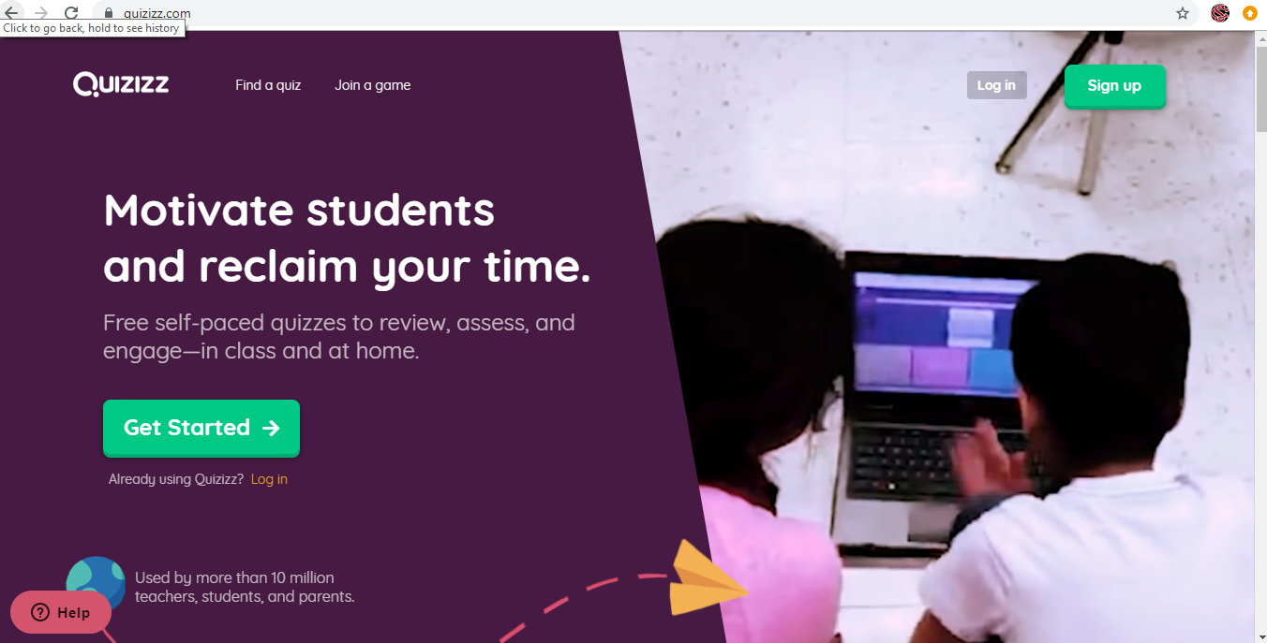
This is the Start Screen when you look up quizizz.com. The “log in” and “sign up” are at the top right hand.

Slide 3
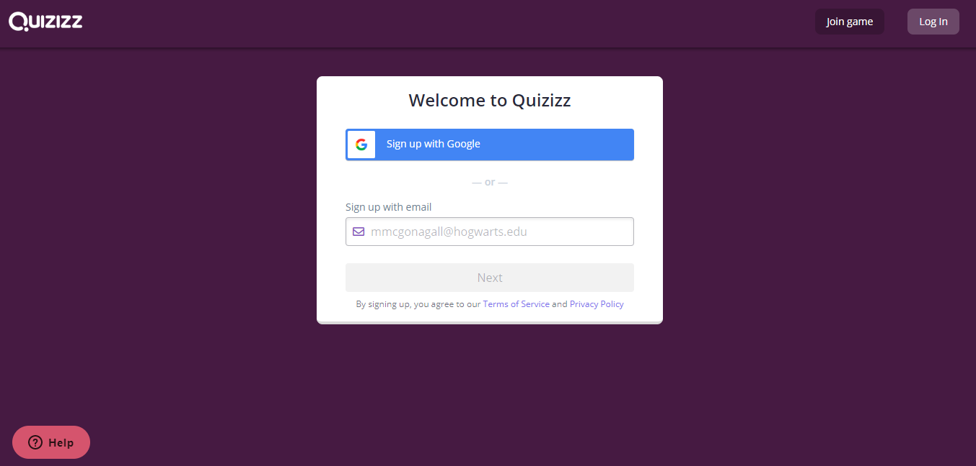
This is the sign up screen; it is easy for students to sign up by using their school google accounts, if your school has them I would definitely have them sign up that way.

Slide 4
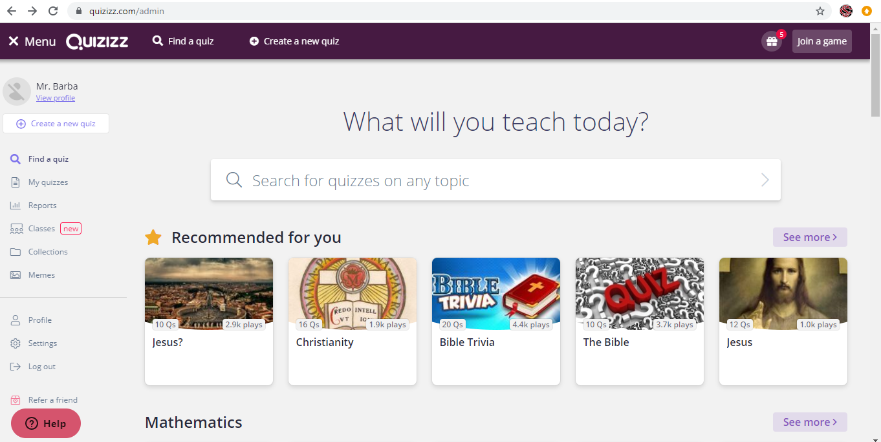
This is the Home Page. You can find a quiz or create a new quiz, among other things.

Slide 5
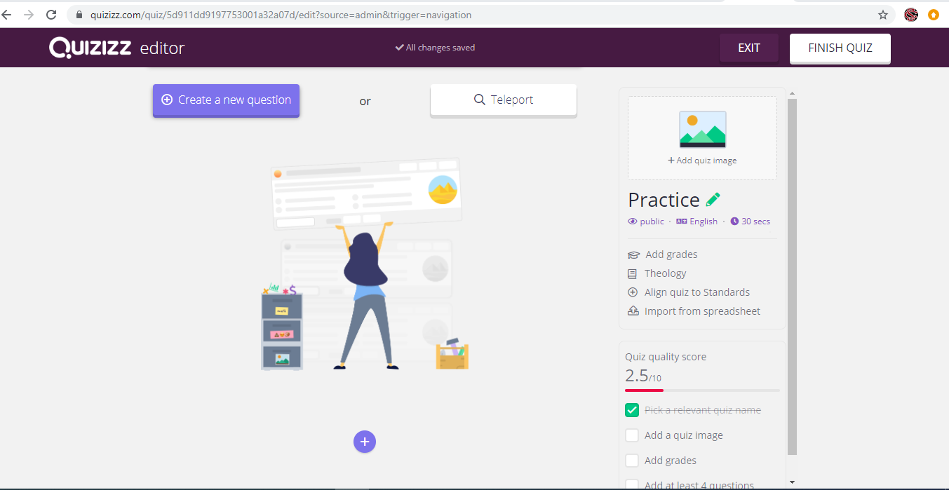
This is the create a new quiz screen. From here you want to “create a new question”.

Slide 6
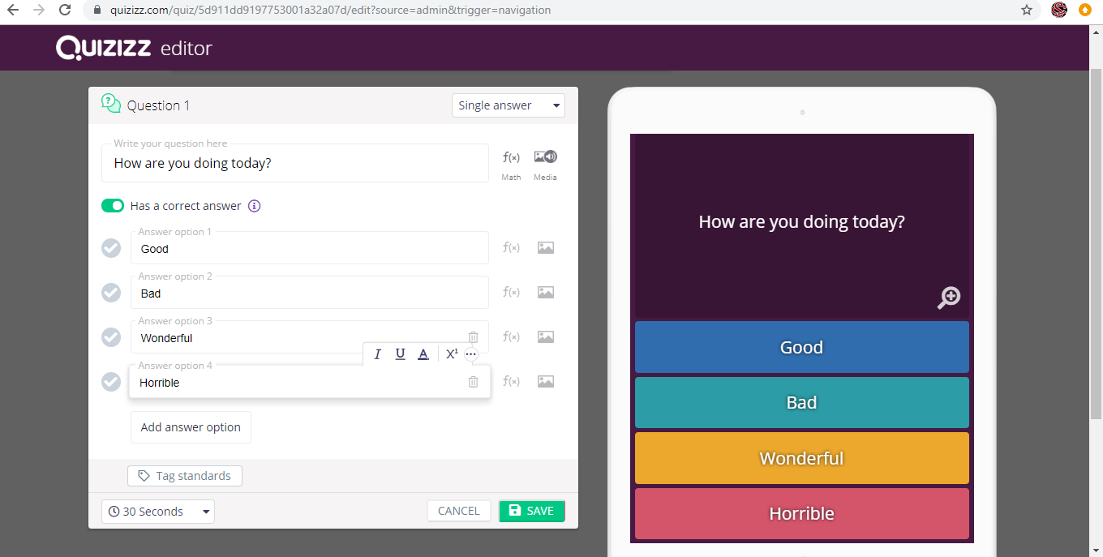
This is the “create a question screen”. I like how it shows you what your questions and answers will look like on a device.

Slide 7
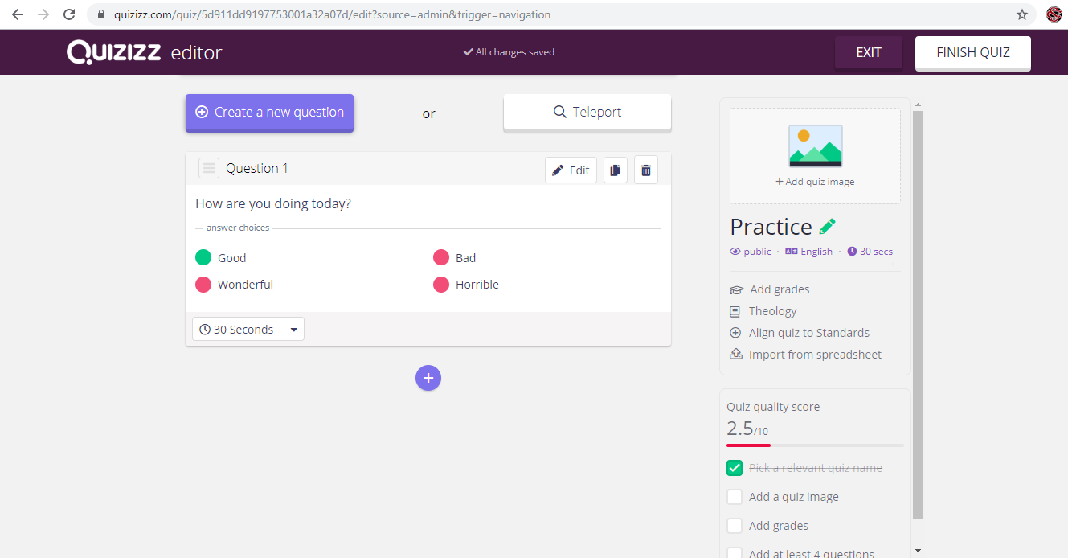
This is what your one question quiz looks like after you’ve created a question. You click on the finish quiz tab after you’ve created all the questions you want.

Slide 8
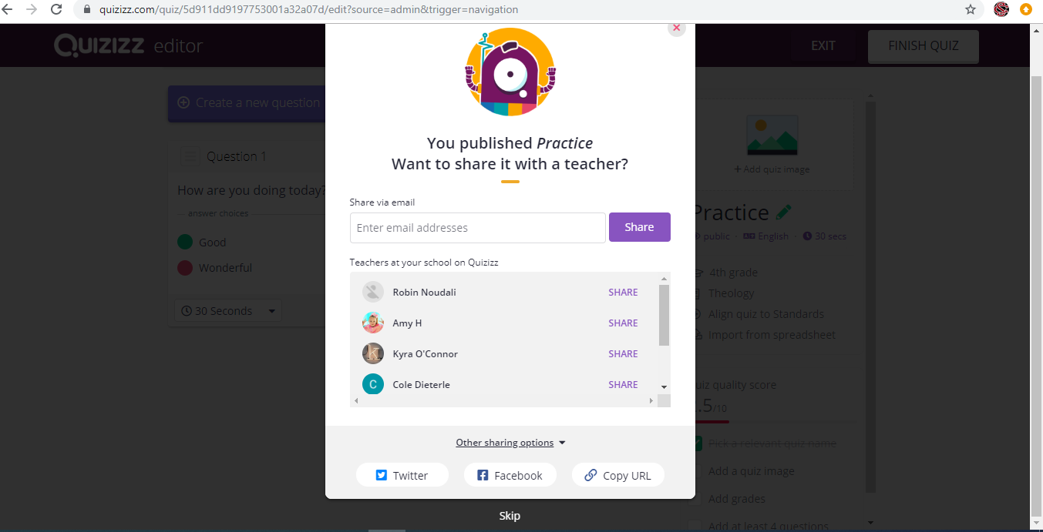
This is the the finish quiz screen which allows you to share your quiz in various ways. I find the copy url to be the easiest.

Slide 9
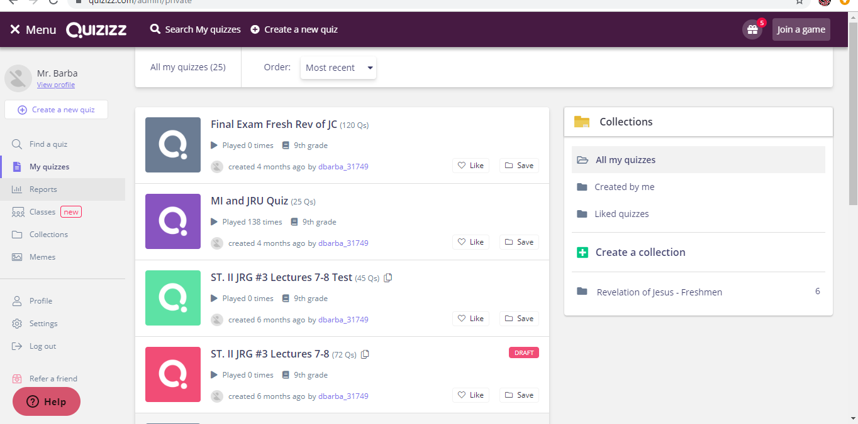
His is the “My Quizzes” tab page. Notice it has all of your quizzes with lots of information.

Slide 10
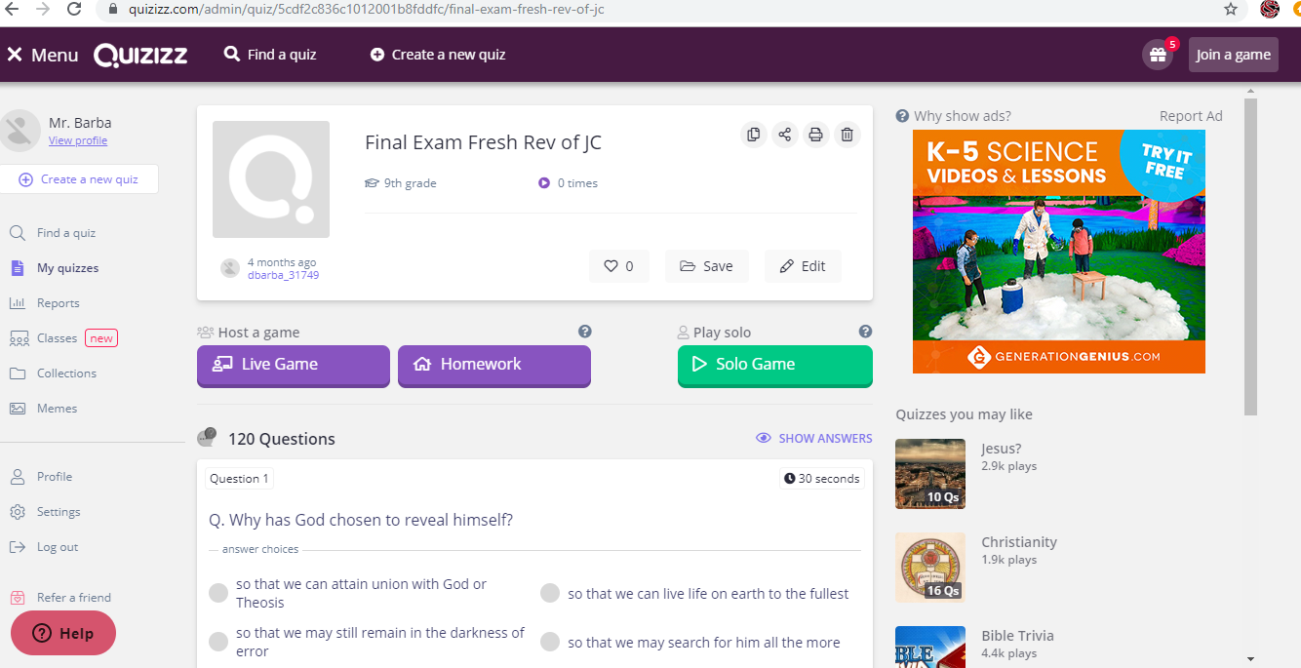
Quiz options for students: Live Game, Homework, or Solo Game.

Slide 11
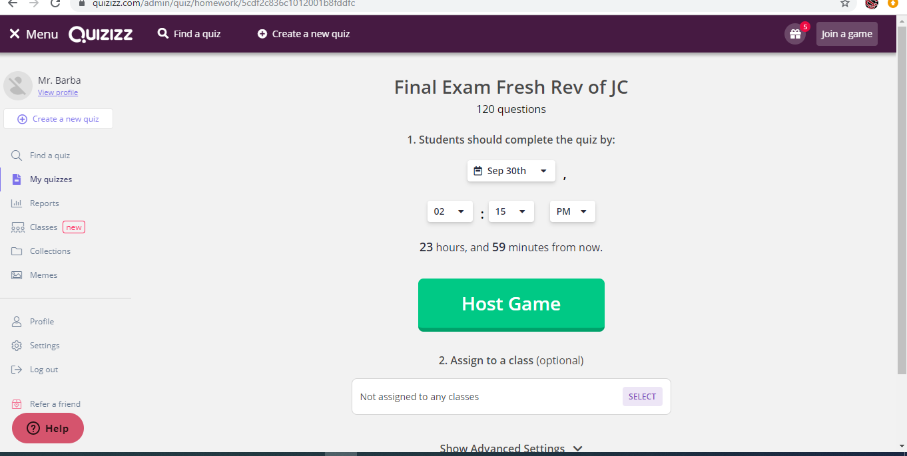
Assigning a Quiz for Homework, setting a due date and time.

Slide 12
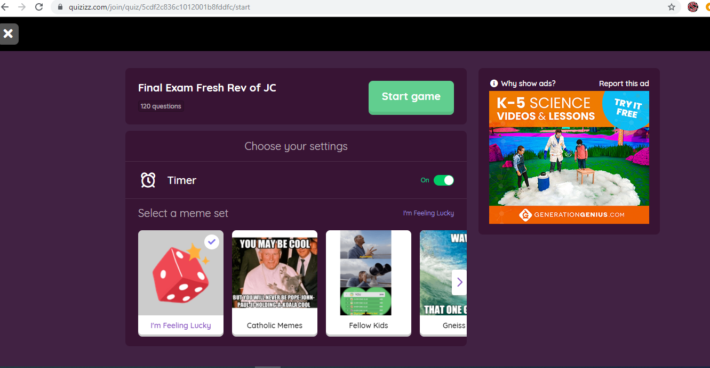
Solo Game Option for students.

Slide 13
Solo game play. Notice the scoring in the top right hand corner, along with the question and streak chart on the top left hand.

Slide 14
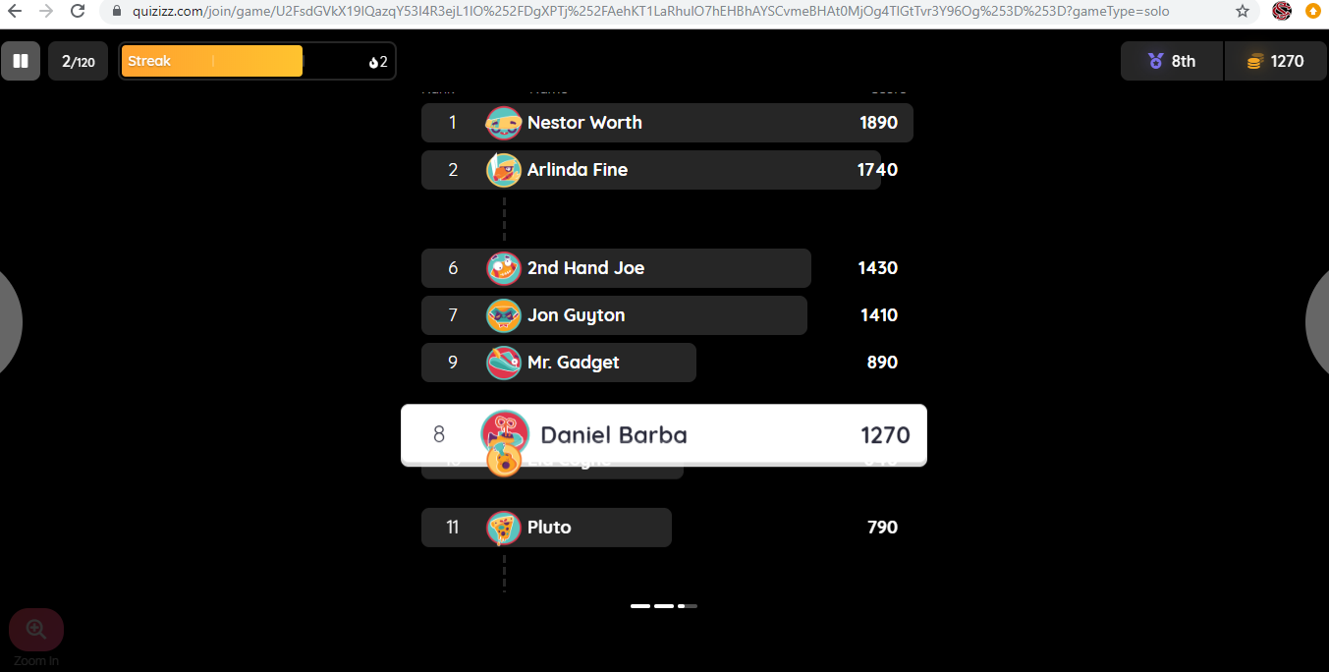
Scoring, this is the screen seen by the students after they answer a question.

Slide 15
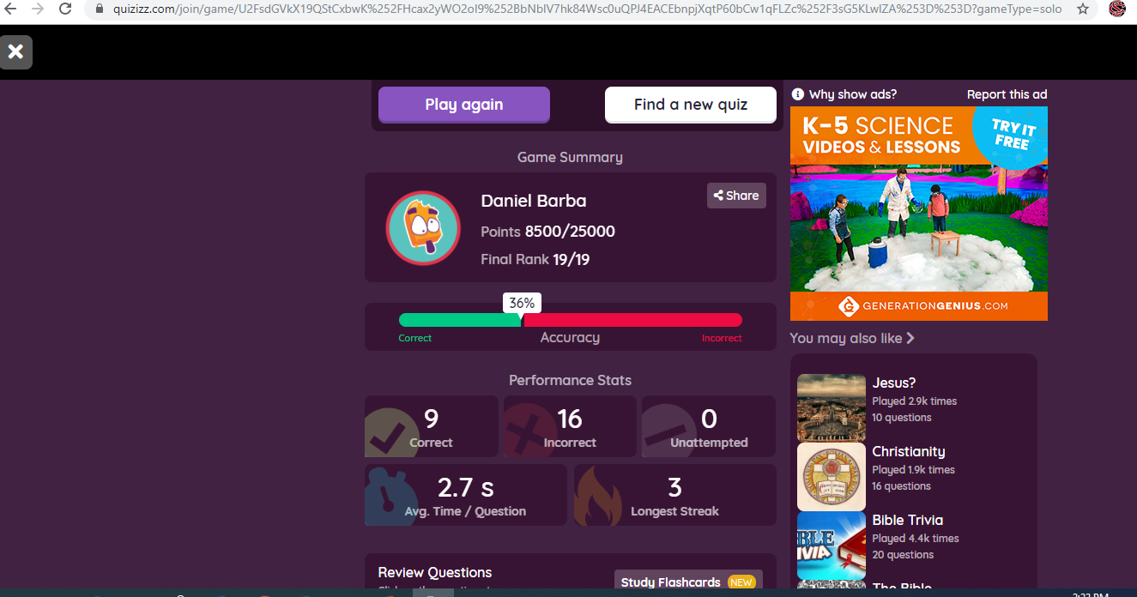
Quiz results after game played. Notice the avg. time per question and the ranking.

Slide 16
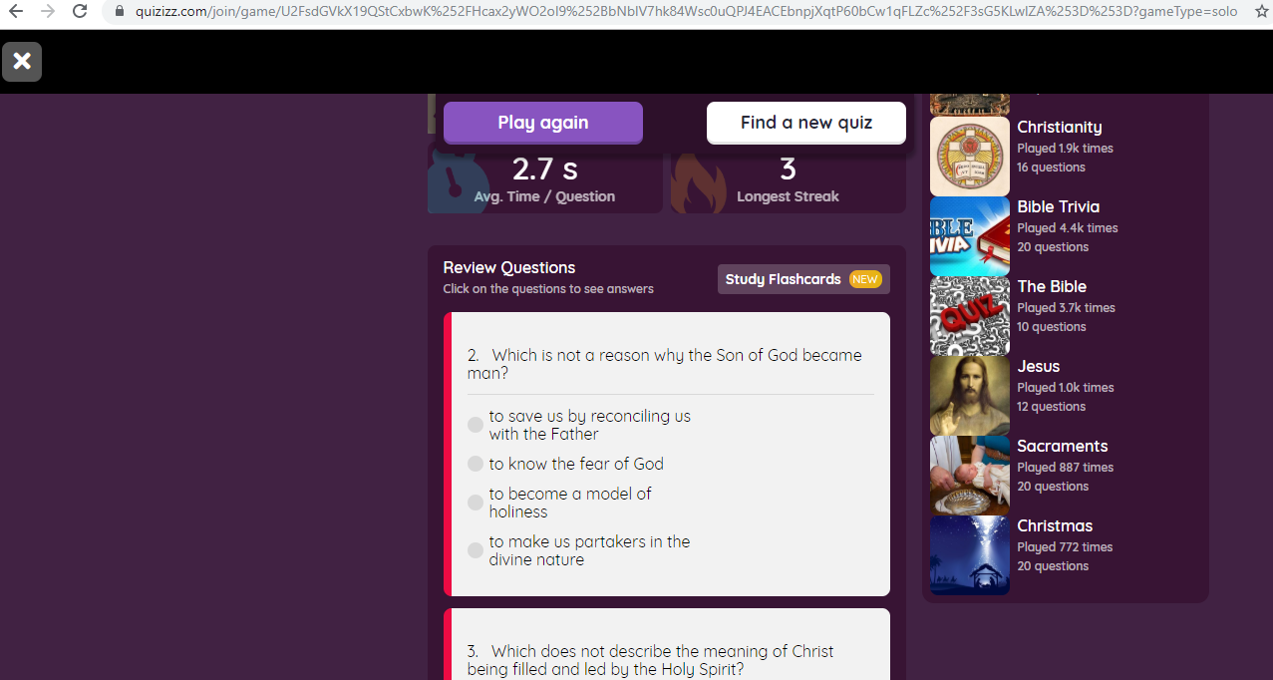
Reviewing Quiz Answer/Responses after quiz.

Slide 17
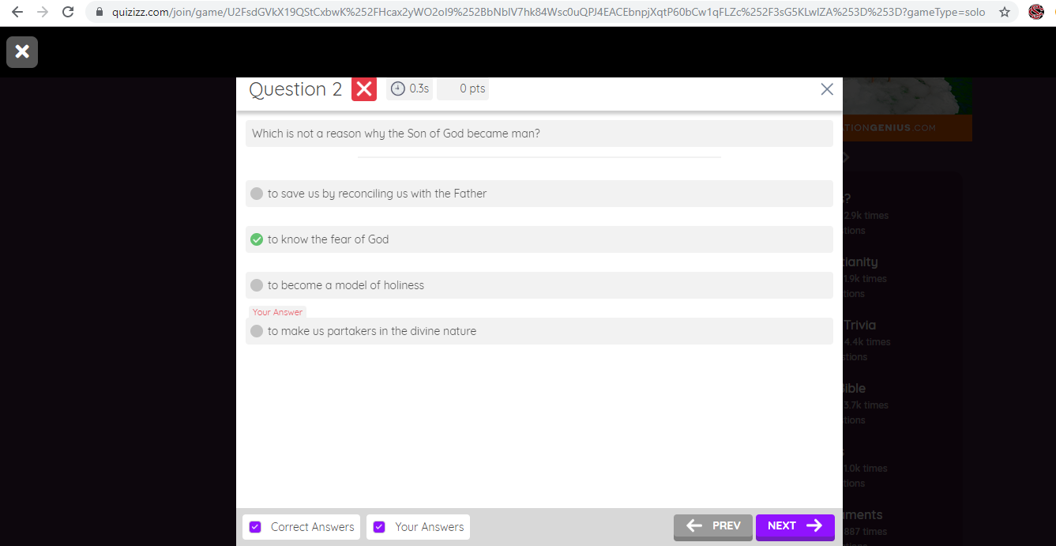
Reviewing individual questions for review. Beautiful and simple format!

Slide 18
Choosing to print a quiz for students to take. Click on the print icon.

Slide 19
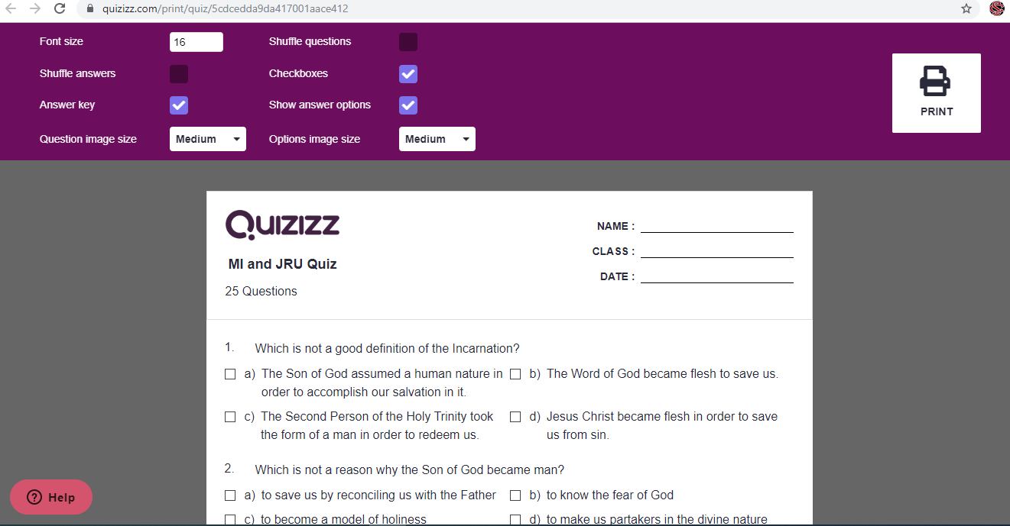
Varied printing options makes it easy for teacher to create multiple versions of test and rearrange questions to minimize cheating: shuffles answers and questions.

Slide 20
I really like quizizz because it is very similar to Kahoot but it allows students to take the quiz at their own pace. Quizizz does not stop the student when the given time has run out. Additionally, students may leave their quiz and start it up at a later time and they will continue where they left off. The flashcard feature for reviewing questions one missed is also a very nice feature. Lastly, I found quizizz because I was looking at creating longer questions and answers. The word count feature on Kahoot do not allow me to copy and paste questions from another document so I came across quizizz and I was able to copy and paste full questions and answers without editing them. I loved this and it saved me lots of time. The “live game” feature was also something I really liked. It allows students to invite other students to play a game. The “solo game” is also very nice because they student is able to play against AI opponents which still makes the game exciting and interesting.
Lastly, I started printing out quizizz for my actual tests and I really liked the shuffle answers and questions feature. It made it easy to create multiple versions of my test very quickly. I would then incorporate gradecam to make the grading of my tests quicker. Overall, I really like the features Quizizz provides, they really help the students work at their own pace in a reward system program.

Slide 21
Quizizz could be classified as an augmentation tech and could possibly me a modification tech. It is an augmentation tech because it substitutes older ways of reviewing for quizzes and provides students with opportunities to review at their own pace and receive rewards as they practice on their key terms and concepts. The various ways of reviewing also provides multiple ways for students to choose the best manner for them to learn. Some may want to focus on the questions alone, some play the game by themselves, and others invite friends to review and play the game.I also see the easy to print features which shuffle the questions and answers as a new way of modifying how teachers approach creating quizzes and test. I see Quizizz as a all one stop assessment creator which also helps students in reviewing for quizzes and tests.

