Slide 1
IXL
Rachel M. Nistler
University of Mary

Slide 2
What is IXL?
ixl.com
IXL is a personalized learning platform that is proven to improve learning outcomes for all students
IXL’s comprehensive K-12 curriculum, continuous diagnostic, personalized guidance, and actionable real-time analytics work together seamlessly to give teachers everything they need to differentiate instruction and help students grow
IXL offers a dynamic and fun environment for learning math, language arts, science, social studies, and Spanish

Slide 3
Comprehensive Curriculum
More than 7,000 skills covering math, English language arts, science, social studies, and Spanish
Support nearly any learning need from pre-K through 12th grade
Each IXL skill is carefully scaffolded and adapts to learners as they grow, ensuring they’re supported and challenged at the right moments

Slide 4
Continuous Diagnostic
Foundation for a new kind of assessment
The IXL Continuous Diagnostic assesses students at a deep level, providing reliable insights on their grade level proficiency on key math and language arts strands
With this portrait of student knowledge always at hand, teachers can make smarter decisions about how to reach every student where they are

Slide 5
Personalized Guidance
Based on student work in the curriculum and the Continuous Diagnostic, IXL creates a personalized action plan for each learner, seamlessly linking to the exact skills that will help them fill knowledge gaps and build on their current understanding
IXL’s guidance provides a flexible pathway for growth, empowering teachers to remain in the driver’s seat and make choices for their students when needed

Slide 6
Actionable Analytics
IXL Analytics makes it simple for teachers to deliver data-driven instruction that supports every student at the right level
Easy-to-use and intuitive reports help teachers monitor classroom performance and growth, pinpoint trouble spots in real time, and group students with similar needs, so that they can use their limited class time more effectively

Slide 7
Brief Overview of Math IXL (most used feature)

Slide 8
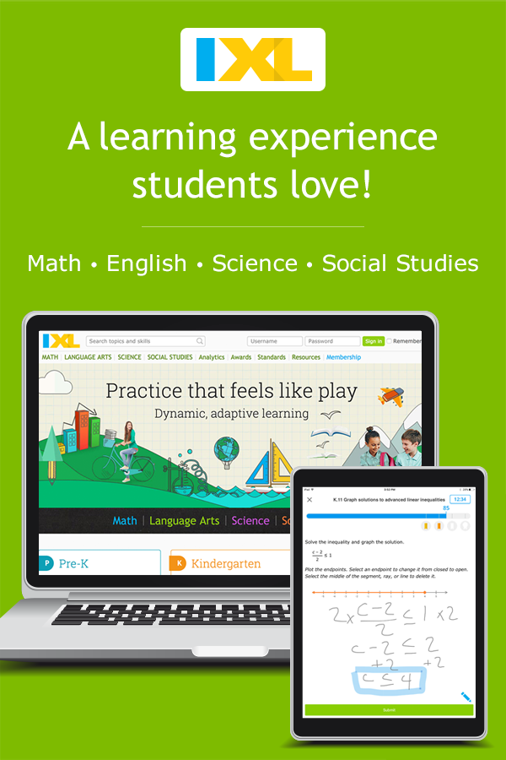
Implementation Models
Whole-class instruction
Blended learning and flipped classrooms
Homework
Intervention (RTI/MTSS)
English language learner (ELL) support
Computer lab
One-to-one
Standards preparation

Slide 9
My Experience
I used IXL Math a lot during this past year (my first year of teaching). I found it incredibly beneficial to use to reinforce concepts taught during the lesson. The websites have aligned to the textbook we use, so it was easy to find what to assign for them.
Typically, I would do a whole group instruction, something hands-on or partner work, their worksheet, and when they finished, they went on IXL and did the skills assigned. To them, it never felt like more work. They were excited to do the questions, see their Smart Score increase, and earn prizes.
If they got a question wrong, they were shown how to solve it, so they could do everything independently.
I was also able to differentiate, as I had a learner at a first-grade math level, who could work at her own skill-level.
There are many different teacher tools, however my favorite was the real-time analytics. On one screen, I could know exactly what skill each student was working on, their smart score, and if they needed help or not.

Slide 10
SAMR
I believe I currently use IXL on the augmentation level. It substitutes practicing problems on paper with doing it online, however, it gives immediate, automatic feedback when questions are answered incorrectly. In addition, instructions are given and the level of personalization is impressive. It allows the students to gain more practice, while I can work with students one-on-one. You can also use data to see what skills are mastered, and what needs to be retaught or reinforced.
As this is a subscription to use, I do not believe I could personally transform it to the modification level. It is designed to teach and reinforce on the lower end of bloom’s taxonomy.

