Slide 1
IXL Enrichment Program
Kolton Keplin

Slide 2
IXL’s Three buttons - Learning - Diagnostic -Analytics
-Each button is able to be clicked on to bring the different parts of IXL page up.
Through each button topics and skills are able to be searched, through the search bar.

Slide 3
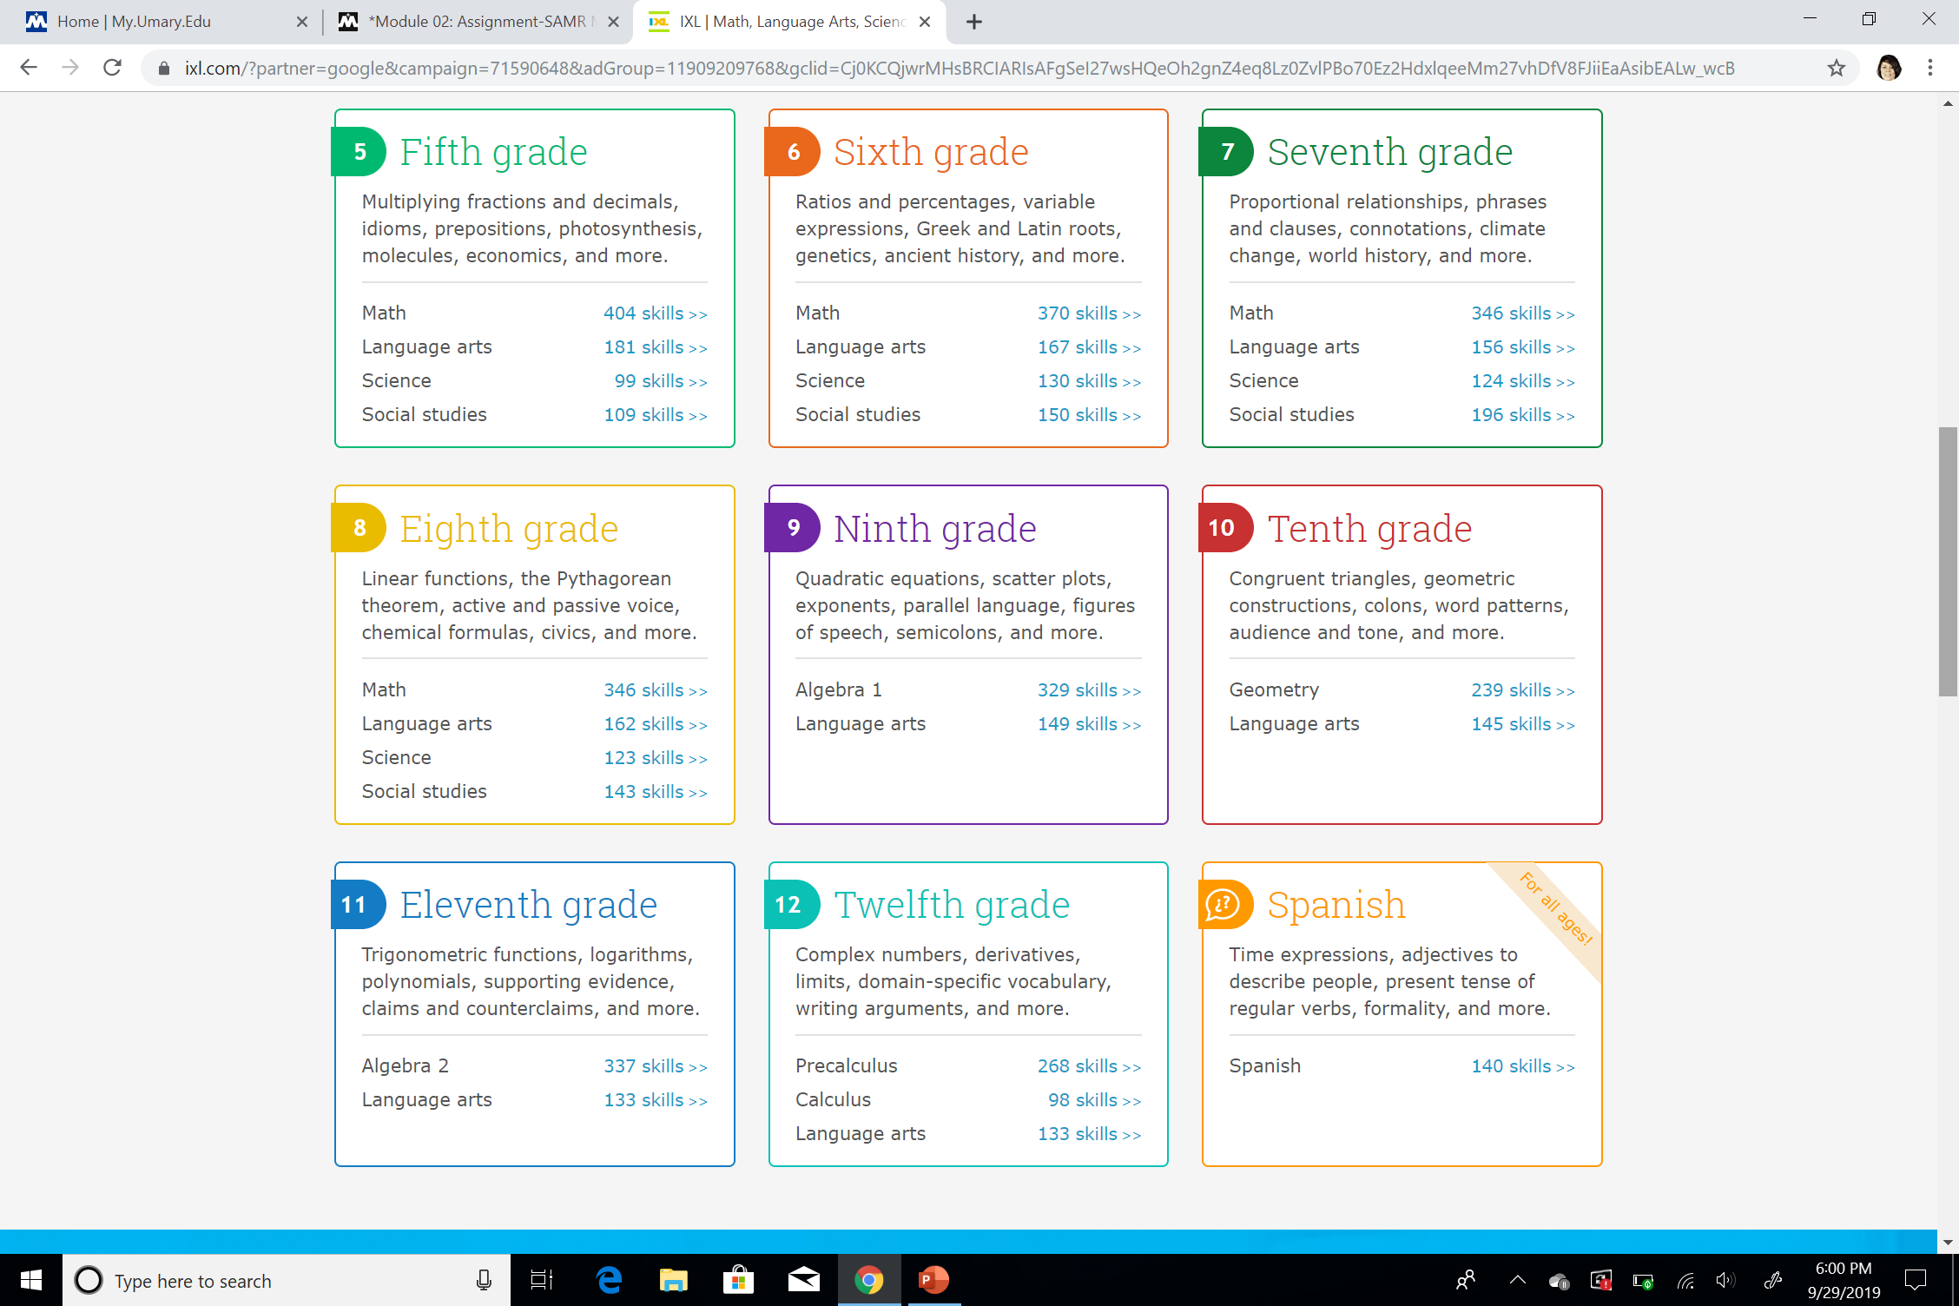
-IXL is able to be used for either Math or Language Arts enrichment. -A lot of times this enrichment is put in place during a Tier 2 or add on for lesson building. -This program is able to be used up to 12th grade. -The Turtle Mountain Elementary School has purchased this program for enrichment throughout the school -and each student is given their individual logins. -During different lessons throughout the school year, this program is able to follow up on different skills for extra work or mastery.

Slide 4
Diagnostics - As stated before each student is given their individual IXL ID so that all of their progress is able to be tracked throughout the duration of their membership. - As students complete different lessons or activities and shows that they have it mastered they are then able to move on to the next concept to build on skills. - The student and teacher is able to see the assessment section to know what they need to work on. - https://www.ixl.com/diagnostic/

Slide 5
Analytics - Students are able to be tracked either by groups or individually to best place them into different needed areas of skill building. - The teacher is able to examine results and assign lessons to best fit the student’s needs. - The teacher is able to teach lessons or concepts to the class as a whole if the same skill needs to be re-taught. - Through the analytics section, the teacher is able to examine each question to see what gave the student a difficult time.

Slide 6
IXL
I feel this enrichment activity does reach each section of the SAMR model.
This enrichment tool can be used as a full classroom lesson, it also can be used to teach to weaker skills or to build on stronger skills.
I also feel that this source can be used to redesign a lesson but yet teach to the main concepts.
All in all I feel that this is a great tool to use for either Math or Language Arts! It teaches to reach a students full potential by building on weaker skills.

