Slide 1
Google Classroom
Cindy Allen
EDU 620

Slide 2
What is Google Classroom?
Google Classroom is a web-based centered created within your Google Drive account.
Google Classroom is a tool teachers can use to create an online paperless environment for students to utilize for many things.
Writing and reflecting assignments
Questions and surveys
Video reviews
Articles or stories for reading
Assessment
Google Classroom is an environment students can use in many ways.
Completing assignments
Reflection and writing
Taking surveys
Collaborating and communicating with other students

Slide 3
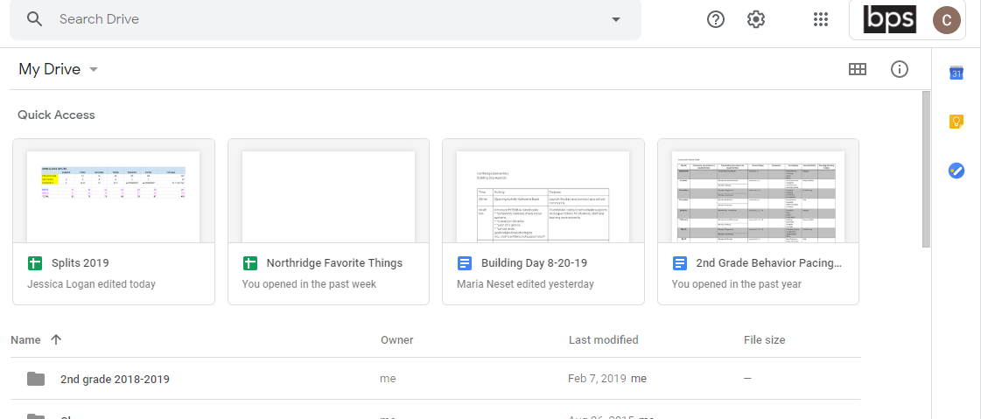
First Steps:
You will need to log into your Google Drive account. If you do not have a Google account you will need to create one. Below is what a Google Drive account may look like.
To get to Google Classroom click on the waffle called Google Apps in the top right corner of your Drive.

Slide 4
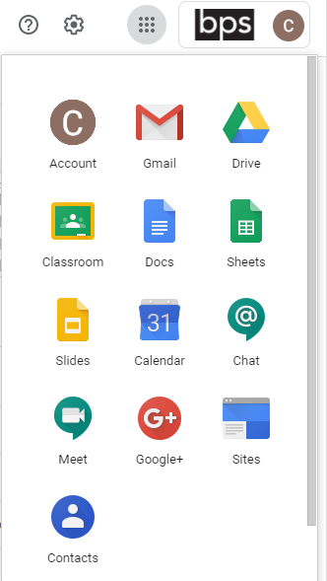
When you click on the waffle, a drop down box expands.
There are many apps within Google Drive. You will need to select the Classroom App.

Slide 5
Below is a sample of the screen you will see after entering the Classroom App. If you have classes already set up, you will see them listed on this page.
To create a new class or join a class you need to click on the “+” (Create or Join a class) button. You can create as many as you need. To enter a class you have already joined or created, click on the actual class.

Slide 6
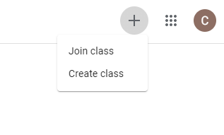
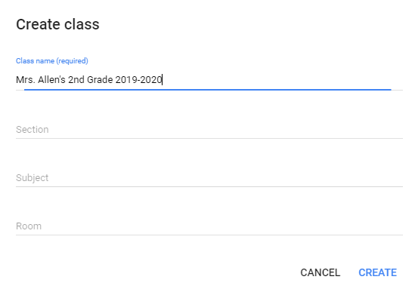
How to create a Class…
To create a new class you need to select the “Create class” option under the “+”.
The system will then have you enter information about the class:
Class Name
Section
Subject
Room
Click “Create” when you are ready to create your new class.

Slide 7
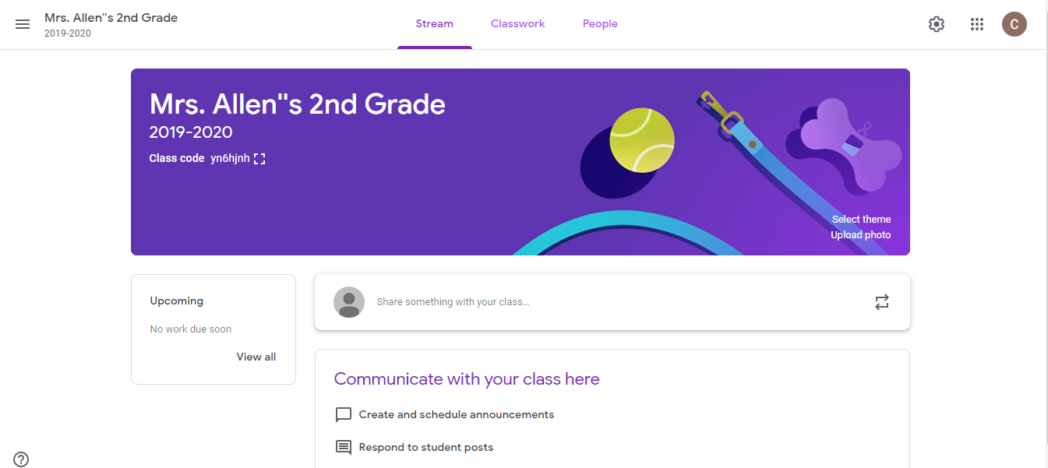
Sections within Class: Stream
Your new class is now set up and you will see your Stream Page. This is where you will communicate with your class.
You can select a theme or upload a photo for you class. This will be seen by students and can help make it easier to identify the class they need to select when logging in (if they have more than 1).
Your Stream page will have the class code you will need to provide to your students so they can join your class.

Slide 8
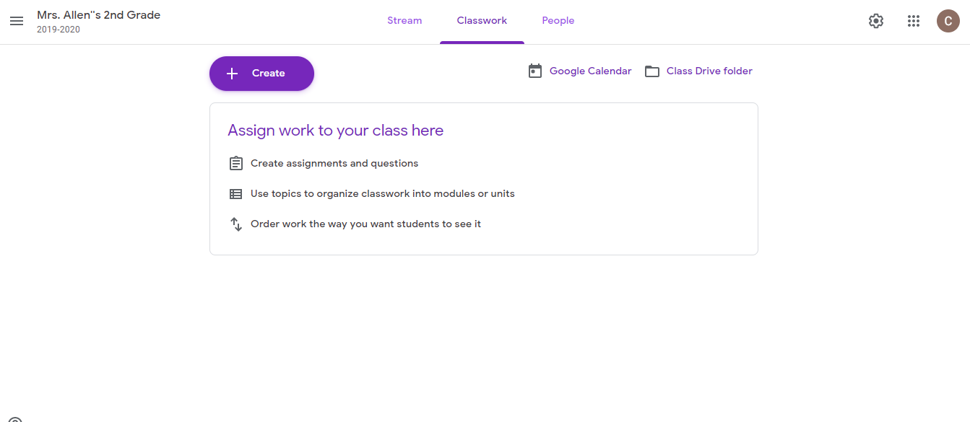
Sections within Class: Classwork
The Classwork page is where you will assign work to your students.
You will create all assignments from this section.

Slide 9
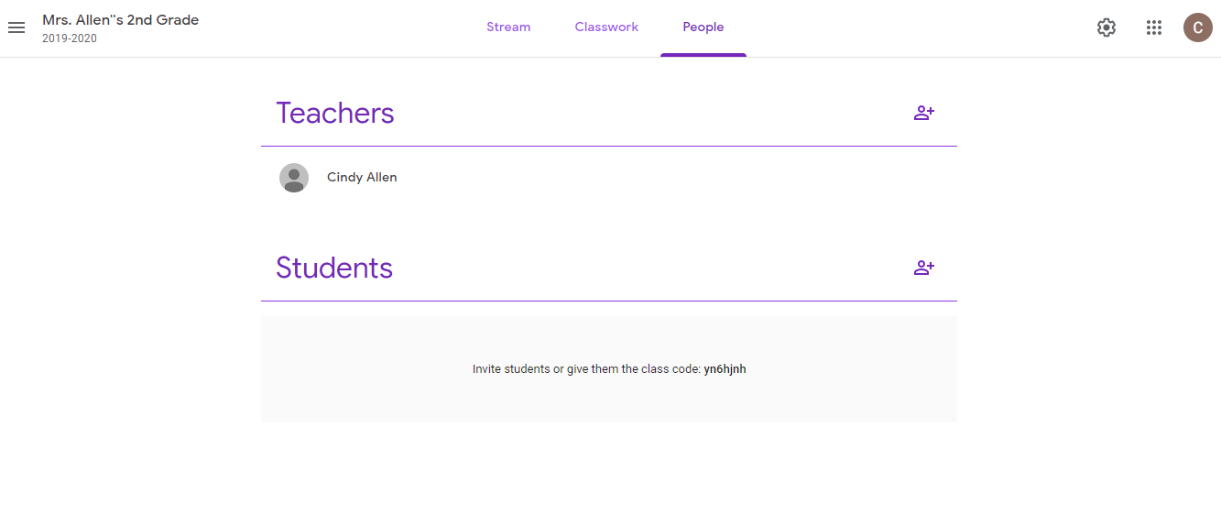
Sections within Class: People
The People section shows who is part of the class. When you are first creating the class you will be the only person listed.
Students need to be added by either:
Inviting them
Giving them the class code.

Slide 10
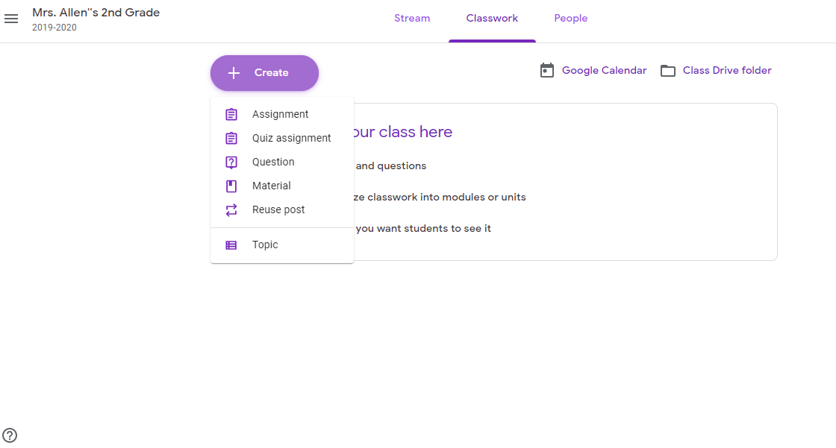
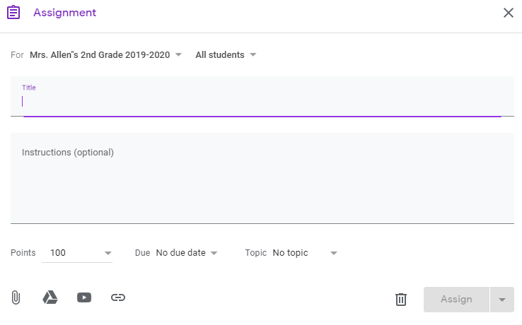
Creating a New Assignment
To create a new assignment, be in the Classwork section and click “Create”.
A drop down menu will appear for you to create the assignment of your choice.
Complete the Assignment form that comes up. There are multiple options to explore for each assignment type.
Links and attachments can be done here.

Slide 11
Students:
Students will access Google Classroom through their Google Drive account just as you do. They will select the class they want to enter by clicking on it.
Students will be able to see and submit all assignments through Google Classroom to you.
Their assignments will be listed under “Classwork”.
If allowed by you, students will be able to see and communicate with other students within their Classroom.
There are assignments where student communication with each other is needed. This is an option you can turn off and on as you see fit.

Slide 12
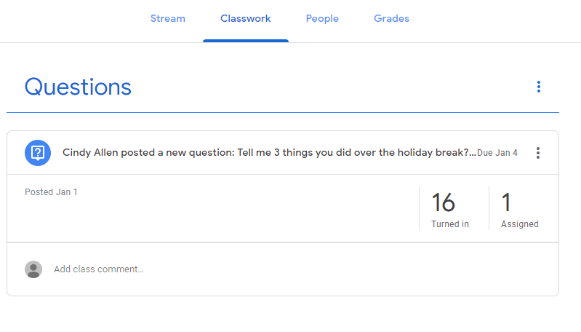
Assignments:
Once an assignment is assigned, you will see it under your Classwork section.
It will show you the assignment and let you know who has turned it in or not.
Click on “Turned in” and it will show you who has completed the assignment.
Click on “Assigned” and it will show you who has not completed the assignment.

Slide 13
SAMR Model Reflection
I started using Google Classroom 3 years ago. When I started using it, I was at the Substitution level of SAMR. I was using it for students to try doing an assignment a different way. I would ask questions, assign worksheet questions with a story, or put up a survey. Students were more engages as it was fun to do the assignment on technology vs paper and pencil.
Over the last 3 years, I believe I have grown in my use of Google Classroom. I am somewhere between the Augmentation and Modification levels of the SAMR model. My students today still do some of the question and answering, but my classroom is now a place of collaboration and communication between students. More assignments are community based and students can read and comment on others work. I have focused in on having student do more reading, writing, research, and reflection within Google Classroom. This gives them the ability to share their thoughts with others and get real time feedback and make changes as needed.
I believe with more time I will reach the Redefinition level. I need to try to find ways of making the assignments more student centered. And I believe this can be done if I utilize the links more effectively and have students reflect and question each other more.

Slide 14
Final Thoughts
Google Classroom is an amazing tool for teachers and students.
Students love it because it is not paper/pencil and they get to utilize the technology in the room.
Teachers love it because all assignments are online and we can easily create assignments at any time.
Google Classroom gets students excited about assignment and I have found I have better responses and turn in rates when assignments are online.
Finally, Google Classroom is super easy to navigate and use and can be a great tool to use in your classroom.

