Slide 1
Technology use in athletics

Slide 2
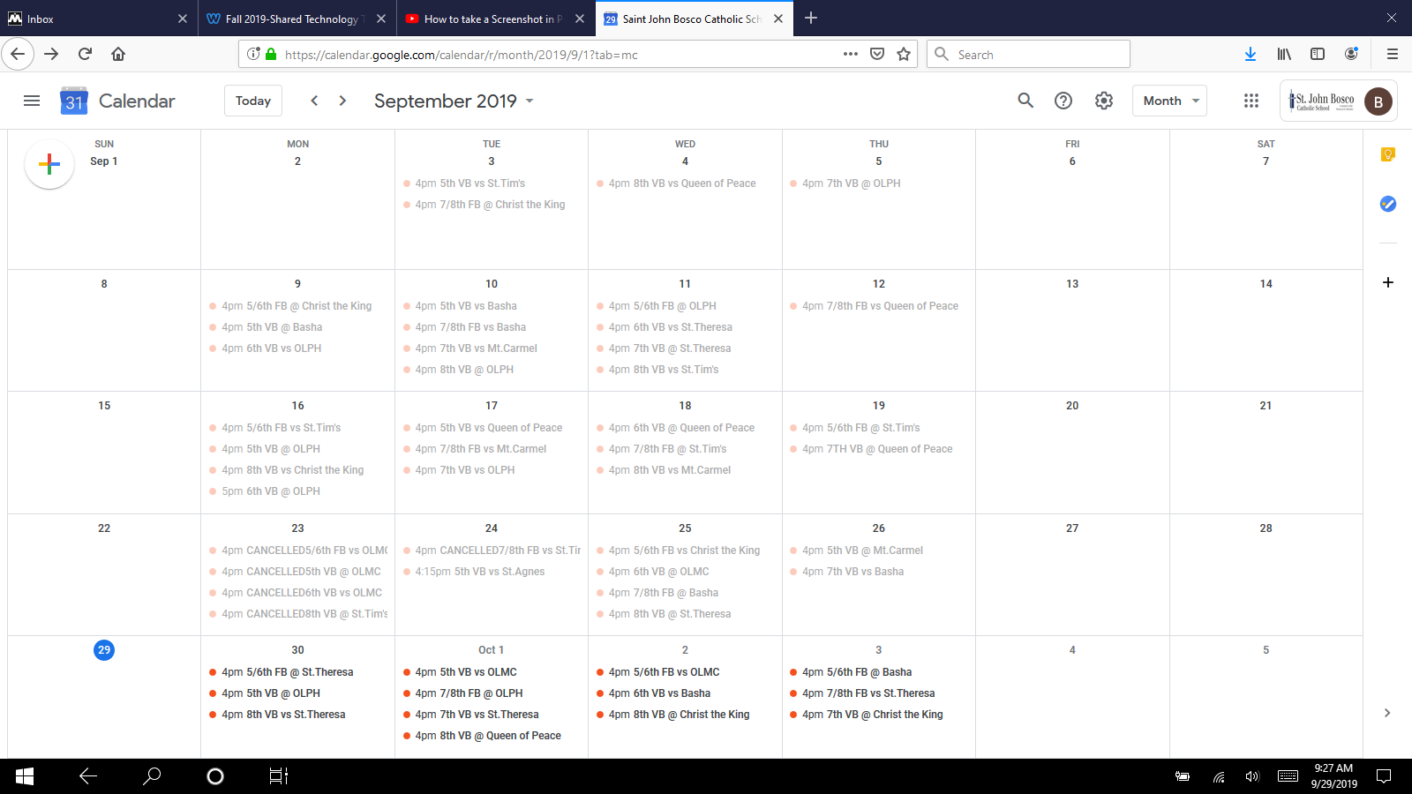
I use google calendar to organize schedules for sports teams.

Slide 3
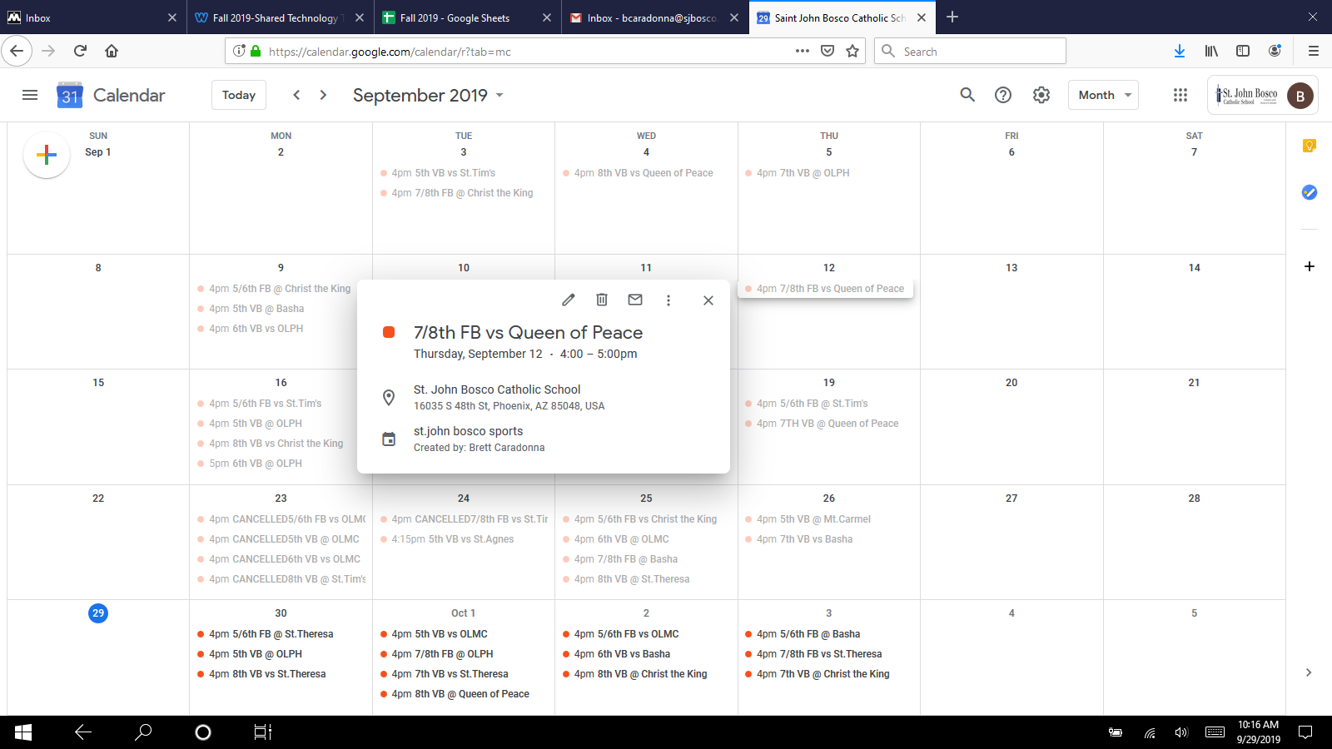

Slide 4
Advantages for using google calendar
Presented well and easy to use for all levels.
Can be shared with anybody who needs access.
Gives detailed info on individual game and locations.
Easy to catch mistakes

Slide 5
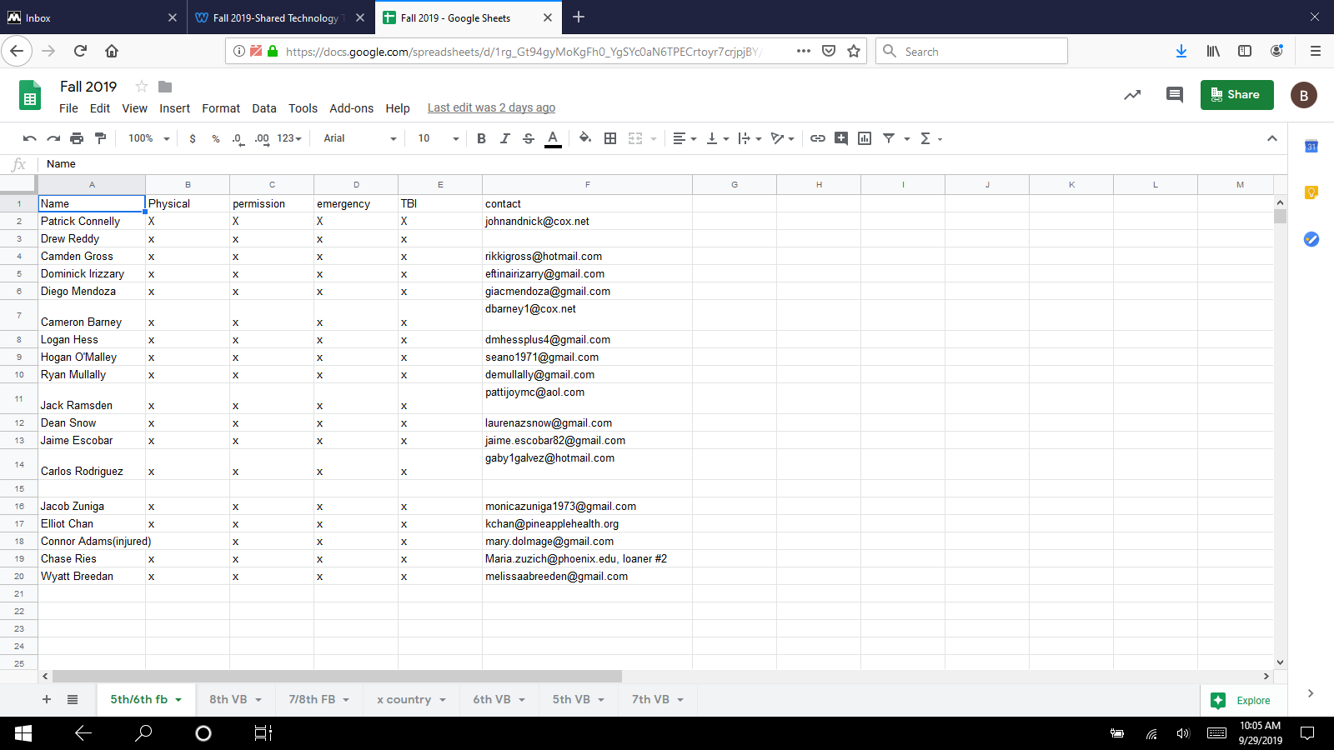
Using excel spreadsheet for roster information

Slide 6
Advantages using spreadsheets
Easy to use and can fill plenty of information per cell.
Can be submitted to others that could benefit.
Updates automatically and saves.

