Slide 1
Using Google Maps in a classroom
By: Mason Rapp

Slide 2
Intro
-Although I am not currently an active teacher, this activity I am about to share with all of you is my favorite thing I used during my student teaching.
The activity is using Google Maps to plan out a road trip somewhere in the United States!
I used this project with a 7th grade elective class and gave them a lot of range on things like; where they were going, how they were getting there, and where they could stop for things like food and lodging.

Slide 3
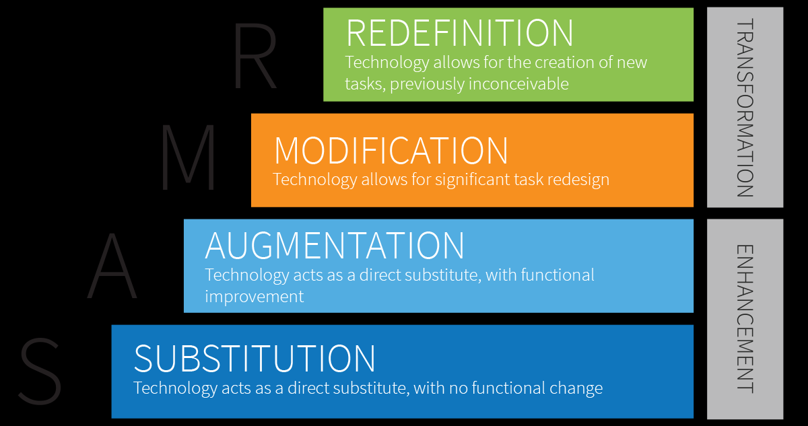
SAMR Model
-According to the SAMR Model, this project/tool is consider augmentation, which means it is a substitute for another tool, but with functional upgrades.
I placed this tool in that category, because my mentor teacher uses this same project, but forces students to use Road Almanacs to plan their trips
Google Maps is a technological upgrade in that sense while also being a substitute

Slide 4
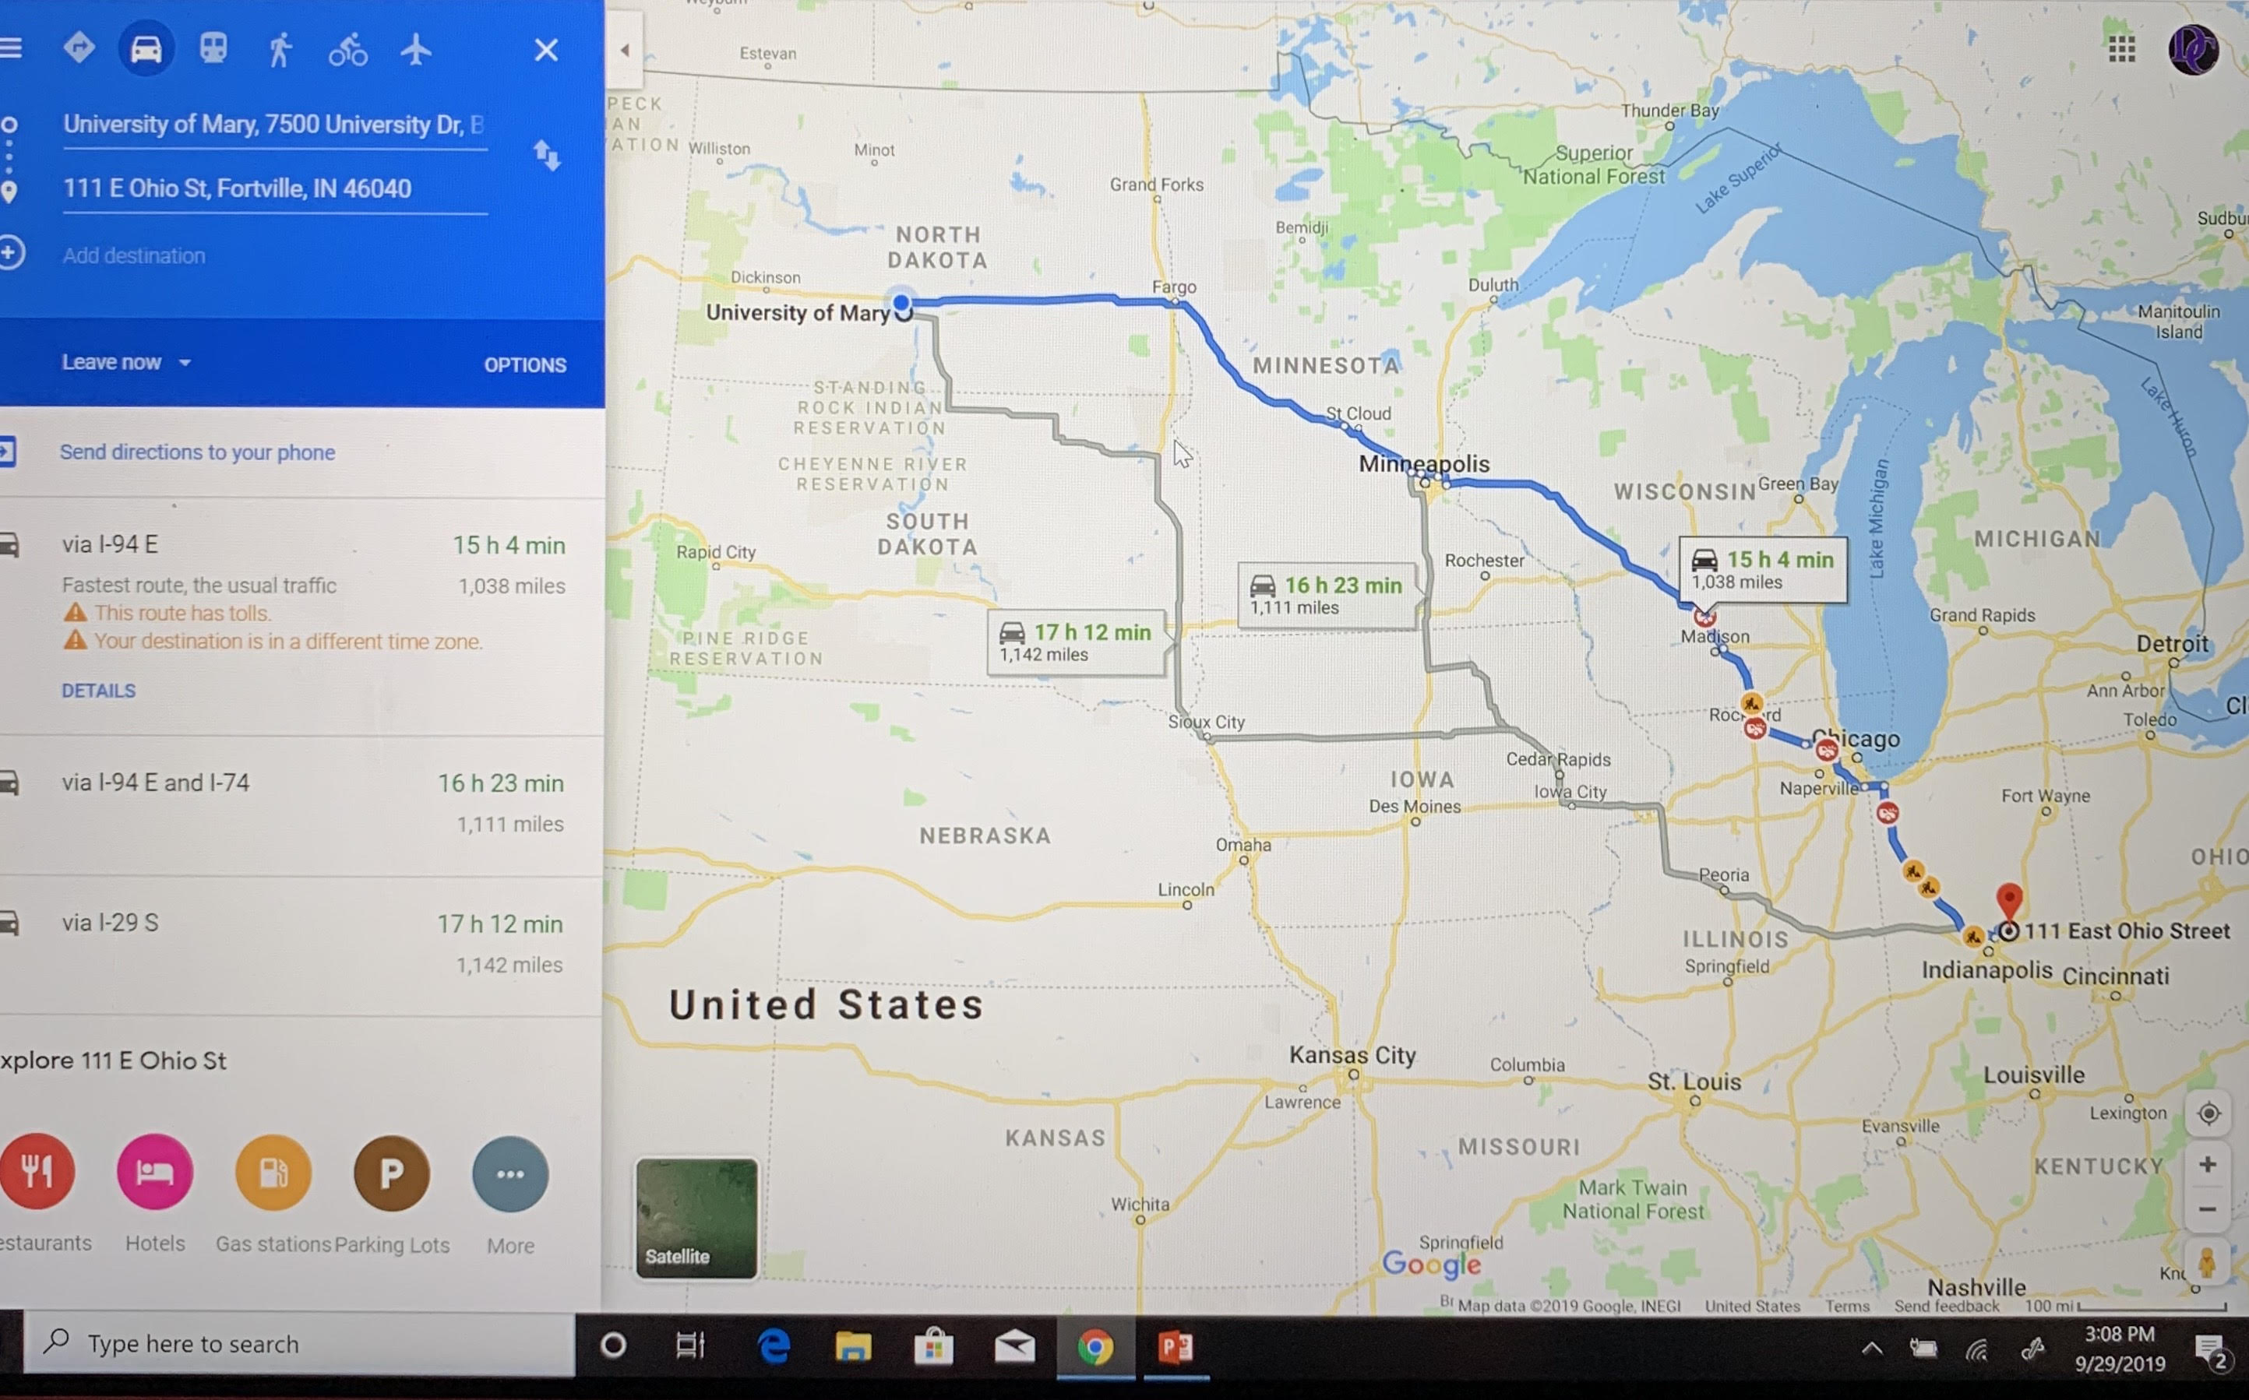
For the sake of an example I used the University of Mary to my old home address.

