Slide 1
Virtual Field Trip
Sr. Mary David Klocek, OP
EDU 620

Slide 2
Vatican Museums offers Virtual Tours
We will visit: St. Mary Major Basilica—Rome, Italy
Follow the link below to explore the tour on your own:
http://www.vatican.va/various/basiliche/sm_maggiore/vr_tour/index-en.html
Exploring the website on your own, you will be able to enjoy the accompanying music, which truly draws you into the experience.

Slide 3
Tour opens with architectural overview:
Clicking on a link or the number above each section, takes you inside for a close-up view.
We’ll try number 1, the Apse

Slide 4
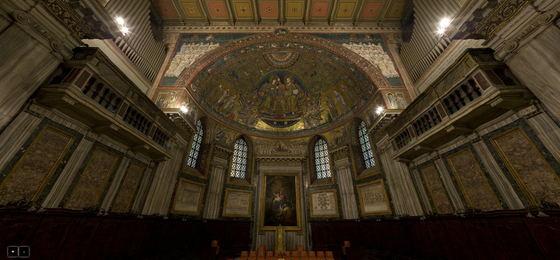
Initial View:
We will zoom in here
Use mouse or touchpad to look up, down, turn around—as if you were there.
Use +/- buttons on lower left, to zoom in and out
Great feature as you can see clearly lots of detail

Slide 5
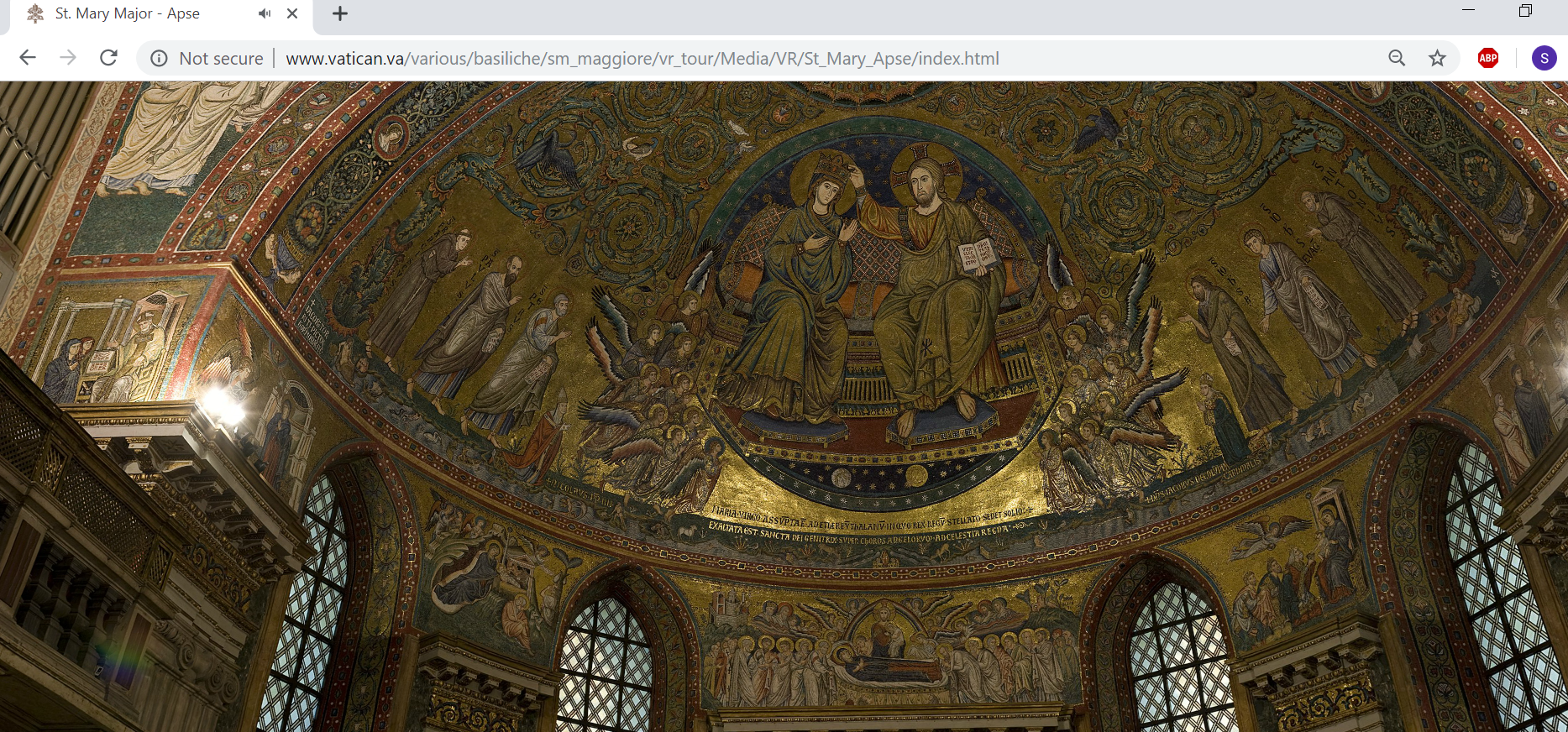
Mini-art lesson: Mosaics!

Slide 6
Theology through art lesson:
Moments in the Life of Mary
Annunciation (above)
Coronation of Mary
Birth of Jesus
Visit of the Magi
Death/Dormition of Mary: movement upward to Coronation

Slide 7
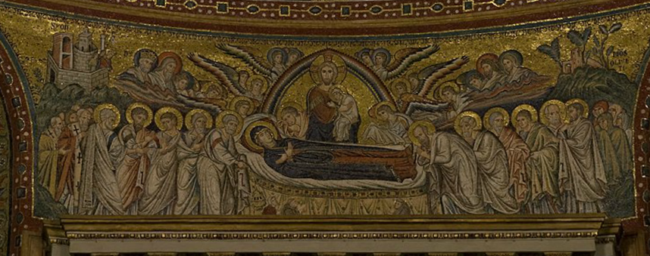
And I can zoom in on any of those scenes . . .

Slide 8
Or on some small detail—like peacocks!
Peacocks—Sign of the Resurrection/immortality
Near the vines of the Tree of Life, Christ Himself

Slide 9
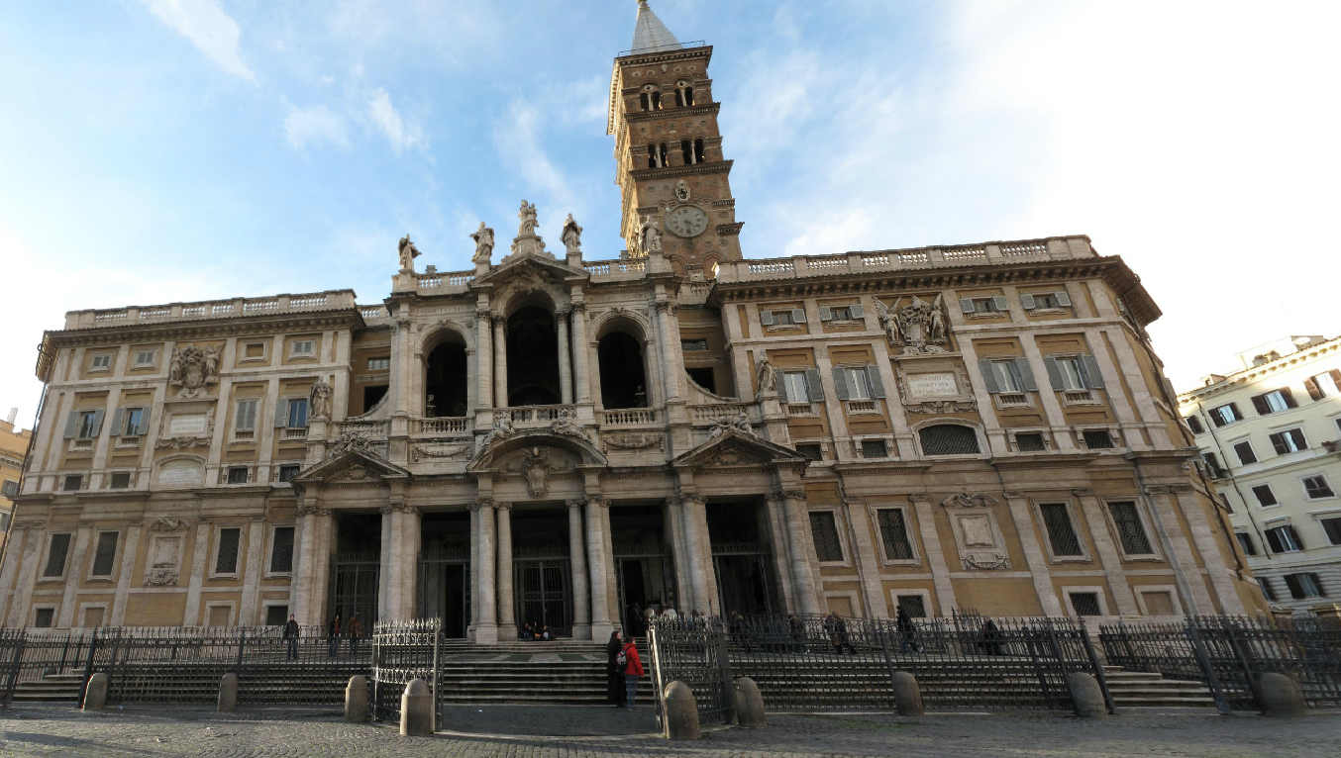
I can go outside…

Slide 10
And turn around, inside, pointing out different architectural or religious features…
Cosmatesque mosaic flooring….Click on link and rotate downward:
http://www.vatican.va/various/basiliche/sm_maggiore/vr_tour/Media/VR/St_Mary_Nave2/index.html
Click & view: Structure above the main altar: Baldachhino, held up on pillars of very rare red porphyry: http://www.vatican.va/various/basiliche/sm_maggiore/vr_tour/Media/VR/St_Mary_Nave1/index.html

Slide 11
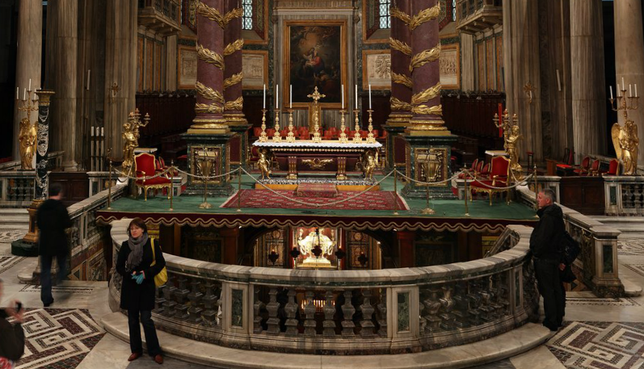
But, then, there is no substitute for what the teacher personally brings…
It is a strange oversight that this tour, although giving a great view especially of the interior of this major basilica, fails to mention one of its main attractions.
Under the main altar is a relic that is said to be that of Jesus’ Manger from Bethlehem:
Pilgrims come from far and wide to pray before it. You can take stairs, right under the altar!
This man is on his way down the stairs.
Manger

Slide 12
How this fits in with SAMR:
Augmentation—Using this virtual tour, and others like it, allows me to do much that I could do a textbook or PowerPoint, but also allows me to add more student interaction with what we are learning. Although I don’t normally do this, I could also allow students to self-direct themselves through the tour, giving them more choice. I find that they get more out of it if I am telling them things as we go, much like we would get more out of a trip to the actual basilica, if we had a tour guide to inform us, rather than if we were left to our own devices.
Redefinition—Taking my students to Rome for tours is not an option, but using this virtual tour makes it almost possible. Having had the privilege of spending time overseas, I am also able to “take my students along” on a tour of things they might never otherwise have the opportunity to see. I am always struck by their observations, even though we are miles away from the actual place!

