Slide 1
Jeopardy Labs
Hannah Smith
EDU 620

Slide 2
What is Jeopardy Labs?
Jeopardy Labs is a website that allows an educator to create your own game of Jeopardy to use with students.
Jeopardy Labs is a great tool to use in the classroom specifically for review games so that students can review the necessary material in a way that is fun and competitive (and is free!)

Slide 3
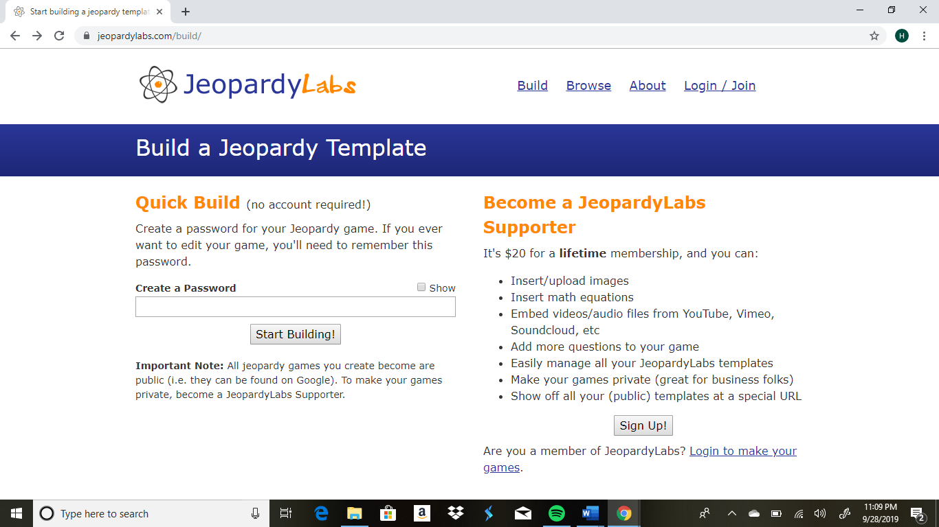
How to use Jeopardy Labs
Visit www.jeopardylabs.com/build
Create a password to save your puzzle (no need to create an account)

Slide 4
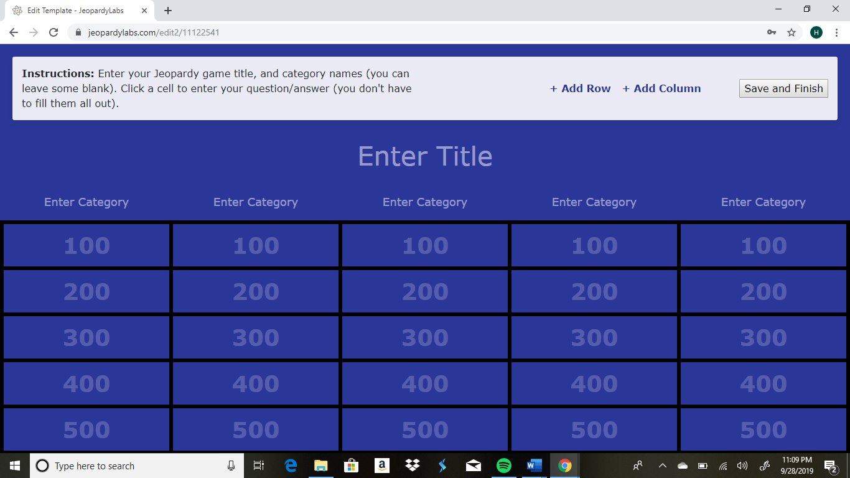
Easily fill in the puzzle title, categories, review questions, and answers

Slide 6
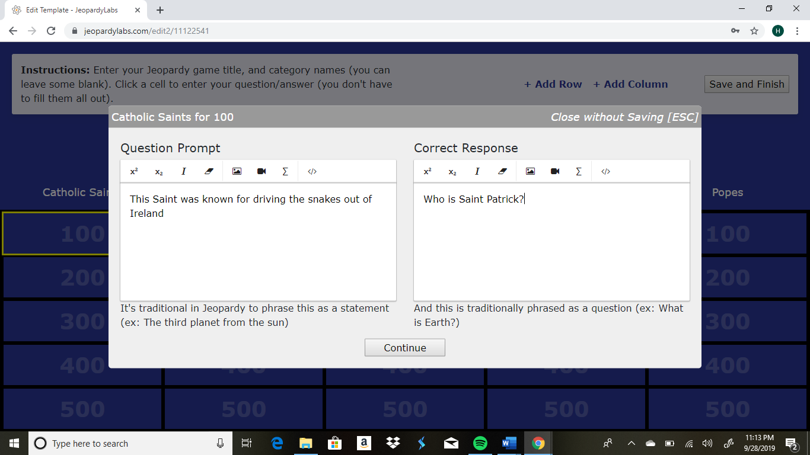

Slide 7
**When you have completed your categories, questions, and answers, select “Save and Finish” to save your puzzle for when you are ready to use it.**

Slide 8
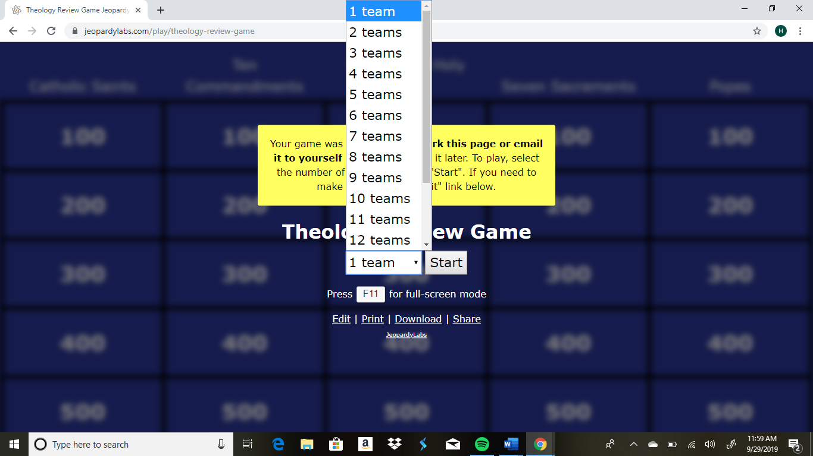
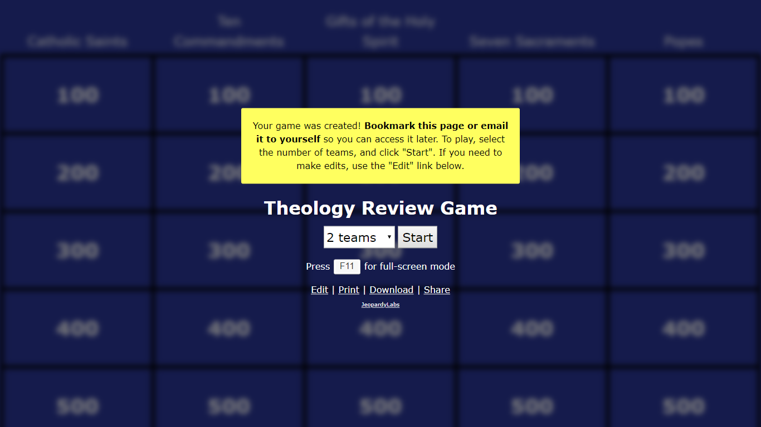
-Once you have selected “Save and Finish on the previous screen, your game is ready to go!
-Select the number of teams you will have competing
-When you have selected the number of teams you will have competing in the review game, select “Start” to begin the game.

Slide 9
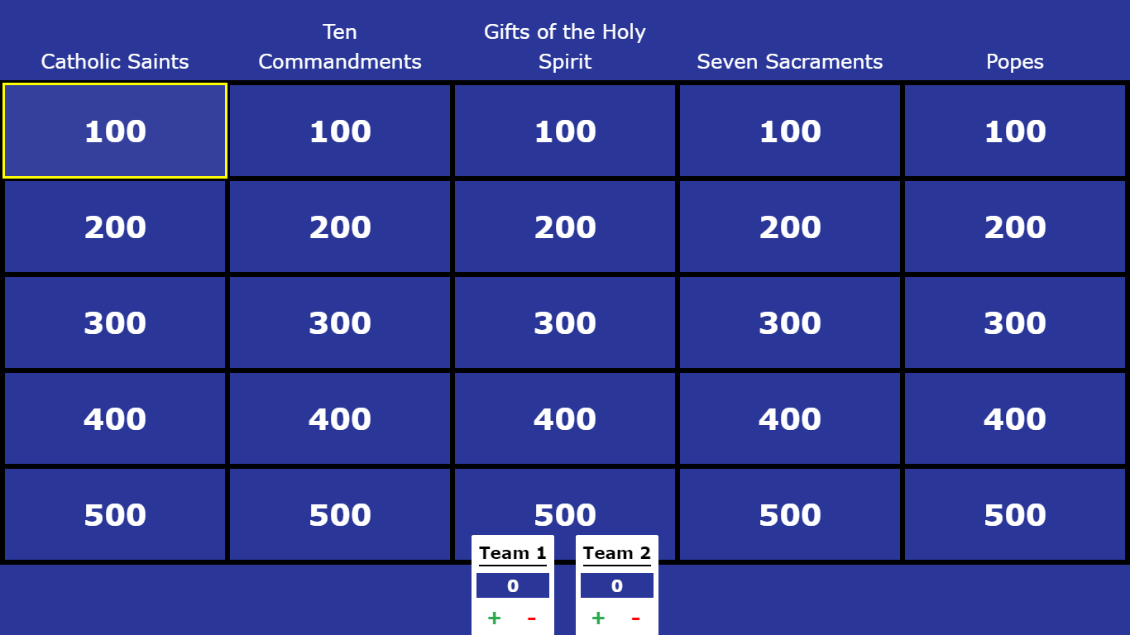
Begin the game by deciding which team goes first
Click on the category and point amount the team decides on
Press the space bar to reveal the correct answer

Slide 10
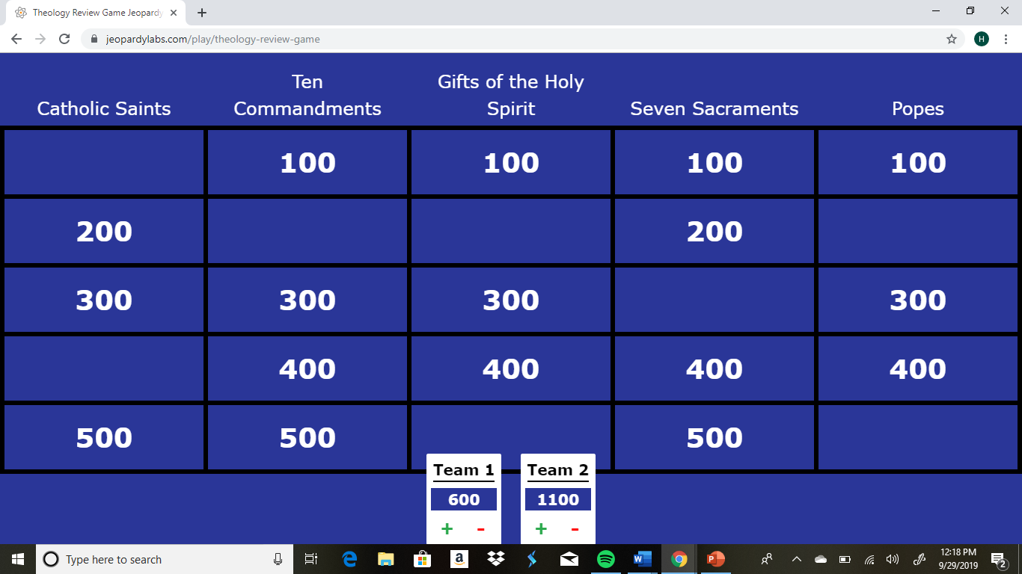
Use the + or – buttons to give points to the team if they answer the question correctly or deduct points from the team if they answer the question incorrectly

Slide 11
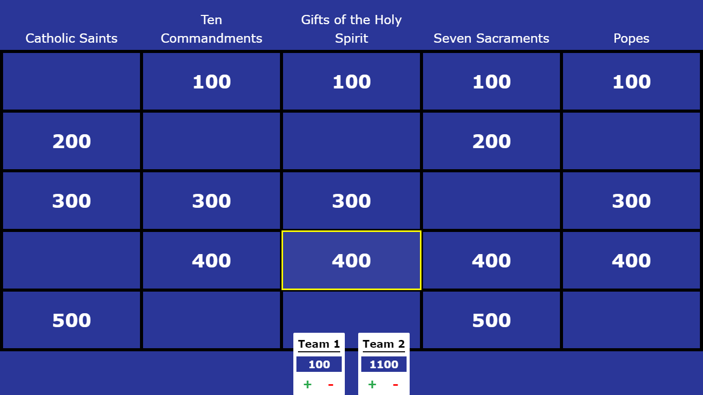
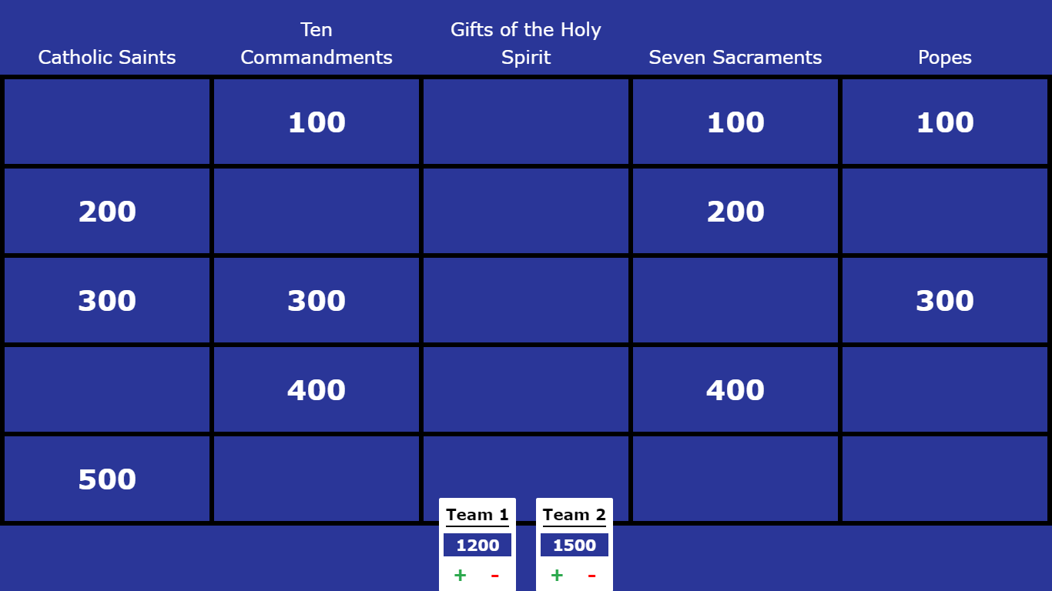
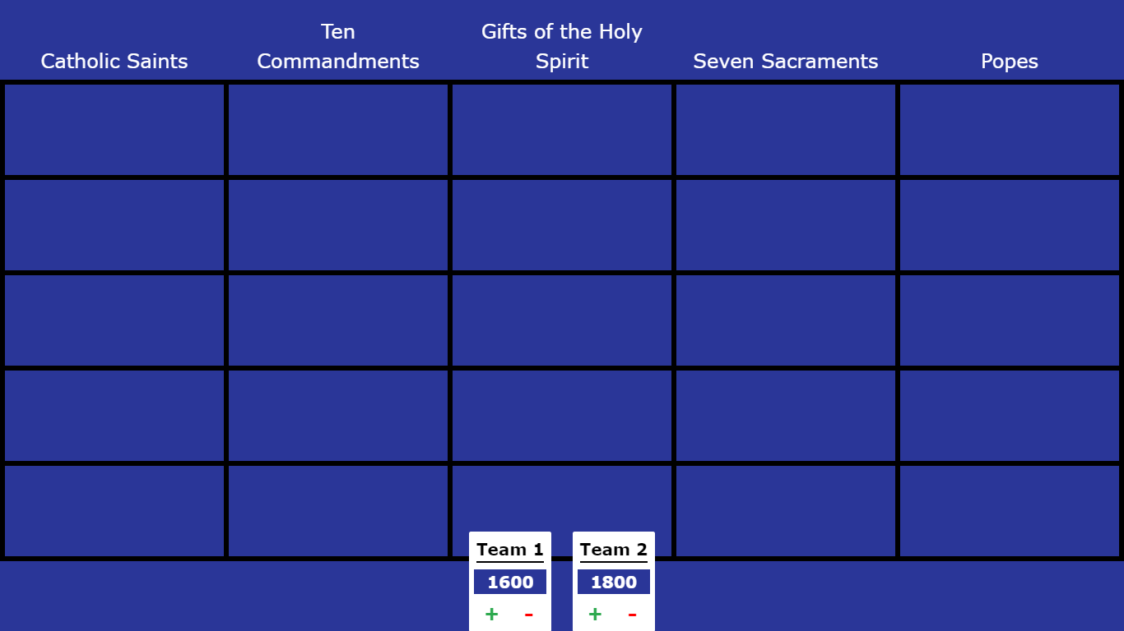
Continue this process until the game board is cleared
Whoever earned the most points wins the review game and receives extra credit points on the test.

