Slide 1
Digital Coaching Center
U.S. Soccer Learning Center

Slide 2
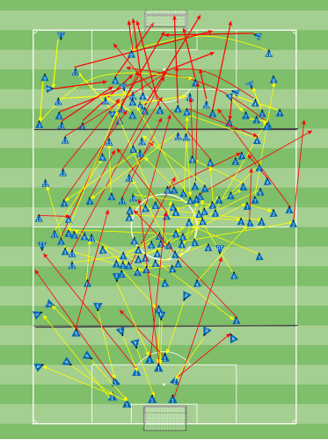
How is the Digital Coaching Center Used?
I use the Digital Coaching center or DCC daily as a tool to design training sessions, as well as create visuals for the players to reference.
This is an example of information given to our players from the DCC.
This shows passing success and failures from the players over a 45 minute period. Red Lines Represent failed passing attempts.
We use this information to help players identify patterns and better understand the game.

Slide 3
What is the Digital Coaching Center
The DCC is an education software for coaches,
as well as a program that helps coaches
design training programs.
The DCC, also gives coaches information
on continued education courses, and
serves as an education portal for coaches
while they are taking coaching courses.

Slide 4
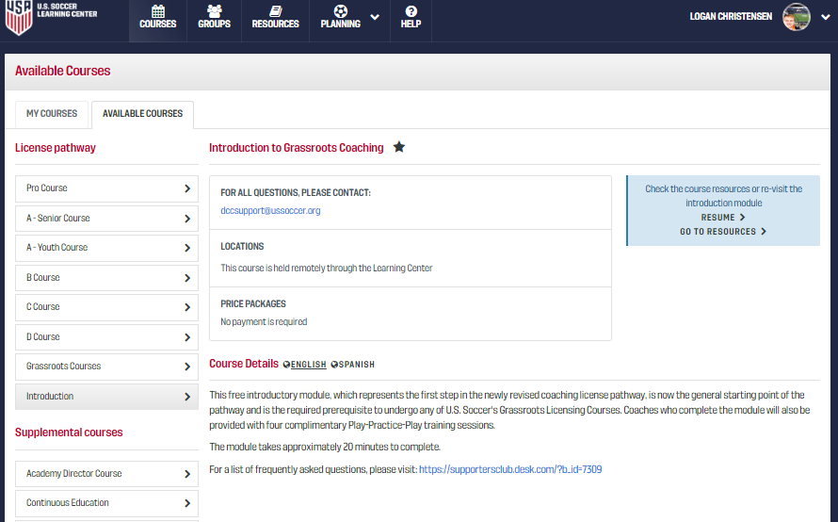
Coaching education
The DCC gives coaches information on when, and
where coaching classes will be held.
It will give Course Details, Eligibility standards for
the course, along with the Course Structure.
The U.S. Soccer Federation requires coaches to achieve
a certain level of coaching before they are allowed to
coach certain age groups.
This is because the learning environment changes for
players as they get older, and so the U.S. Soccer Federation wants to make sure player development is happening in an effective manner.

Slide 5
Completed Course inforamtion
The DCC will give coaches access to previous courses
completed, along with the ability to download
certificates from the courses.
It will also give access to completed course info,
For the coaches to reference and use.
This includes, group members, resources, past
assignments, a library, communication,
and evaluations.

Slide 6
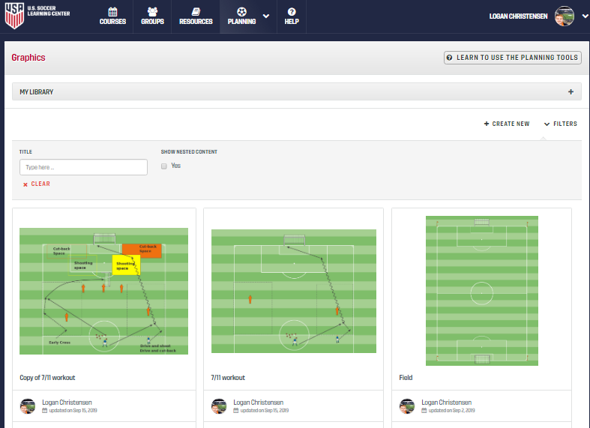
Training session planning Graphics
The training session planning section is divided into four sections.
The first is the “Graphics” section. This is where the coach creates a graphic that will be used in the training session.

Slide 7
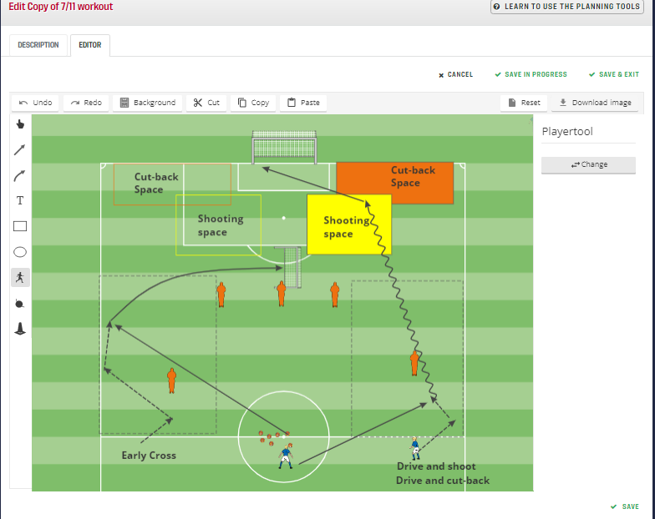
Graphics
This is an example of a training session I created on 9/20.
The Graphics section of the session planning process is important to understand, because it gives coaches the chance to create an idea and gives them an opportunity to see it drawn out.
It has a variety of options and graphic tools, that allow coaches to be more free in developing their plans.
It also allows the coaches to create graphics for players to give them visual representations of what the coach is trying to teach them.

Slide 8
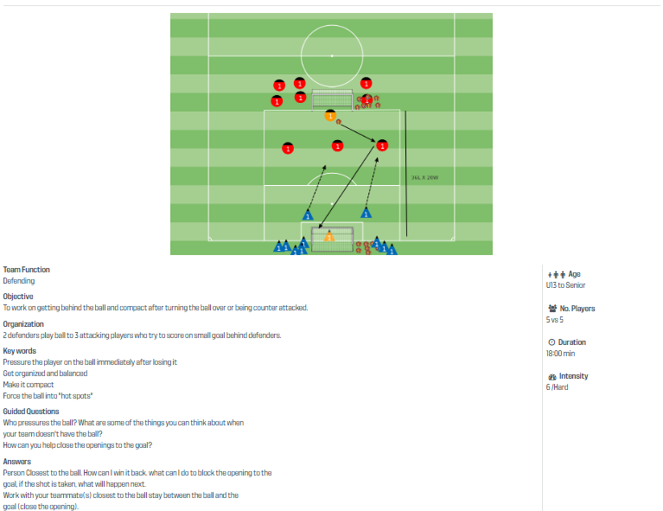
Training Session planning Training exercises
The Training exercises piece of planning allows coaches to
define the purpose of the training session.
This includes the
Team Function
This is the area you want the team to improve on.
Organization
This is how the activity will be set up, and how the rules will be used.
Key Words
These are the key words a coach will use during the session.
Guided Questions
These are the questions the coach will ask the players.
Answers
These are the answers the coaches want the players to discover.

Slide 9
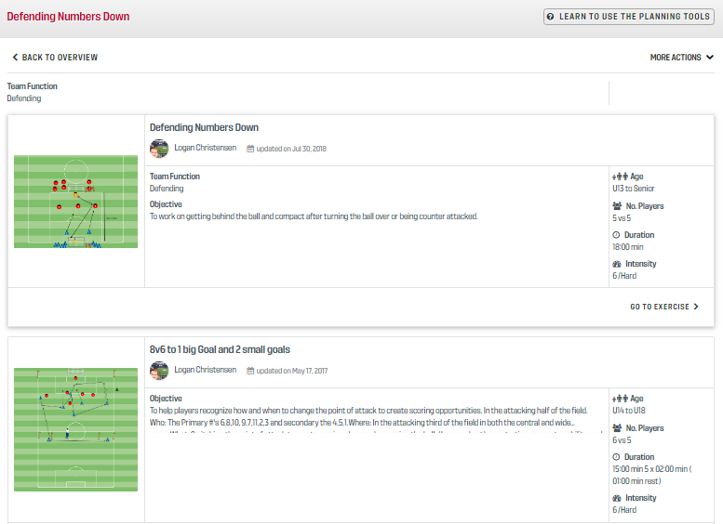
Training Session planning Training Sessions
The Training Session section of session planning, gives coaches the opportunity to look at the entire training session.
A complete training session will include Four Graphics and Four training Exercises.
The typical format for a training session would be
Warm-up
This is when player show up and involves a ball
Small Sided activity
A small version of the game focused on the topic of the session, with limited intervention from the coach.
Learning Phase
This is more game like and will have more questions asked from the coach
Session will always end in a game

Slide 10
Why we use the digital coaching center
The Digital coaching center allows us to create graphics to give to players, to educate them on things they will see in the game.
It gives coaches an opportunity to further our education and grow as coaches.
It gives coaches an environment where we can collaborate while taking classes.
It is a very useful software that gives coaches a chance to design and build training sessions.

