Slide 1
Quizizz.com
Justin Folk

Slide 2
What is it?
Quizizz.com is a free classroom website.
Helps review material for a test, quiz, or just as an exit ticket
Can send out links and the codes from google classroom
Can also start it in the classroom and as a real time game
Sends feedback to the teacher and if used as an exit ticket can see where students are getting tripped up
I also use it to help me modify tests for students with an IEP

Slide 3
Starting out
Go to Quizizz.com
In the upper right hand corner if it is the first time click sign up. If you have a login simply login
It will ask if you want to link it to a google classroom account. If you don’t choose it then you can later.
For the student they will click on the 2 in the left hand corner.
Students will almost always spell the website wrong
I am going to login to show you from now on what you will see as a user

Slide 4
Quizizz
This is the after login screen
You can either search for any topic or on the left hand side is all your information
If you click on the left it will show all thee quizizzes you have created and all reports

Slide 5
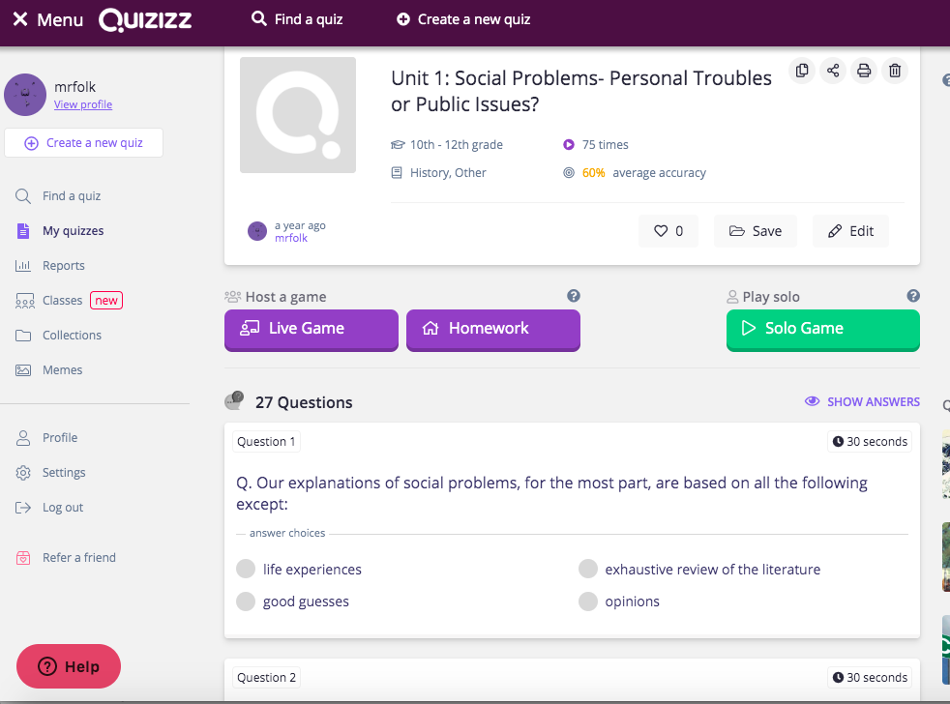
My Quizzes
Under my quizzes you can see all the quizzes I have created and used
If I click on one a new box opens
You can choose live game which will give a code for the whole class and placings or assign it as homework for a certain time period. I use this most often and set a goal they must reach to be done with the assignment. I usually will say something like:
You can do this as many times as you would like but you must get an 85% to get an A. They are the same questions and it is usually information I want them to know. If I do put it in the gradebook its usually for say 5 points but they realize they remember the information and start doing it on their own multiple times later in the year

Slide 6
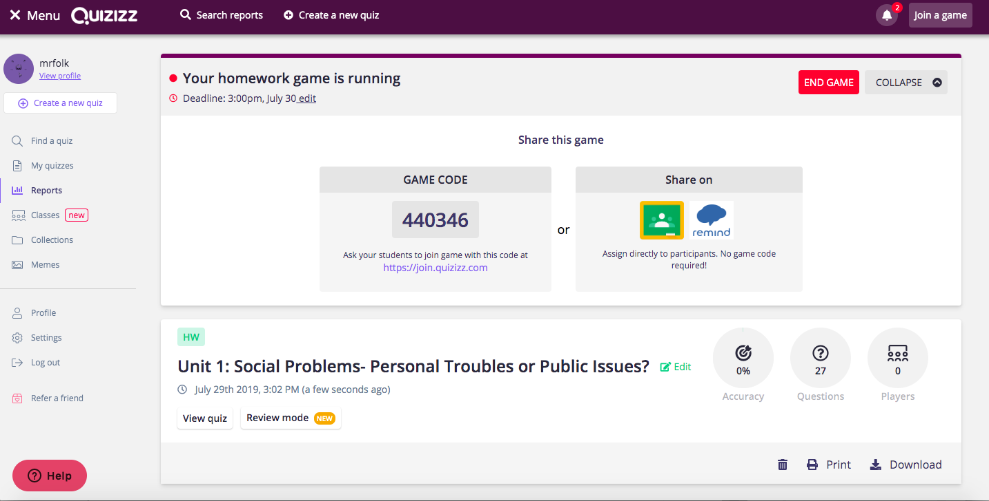
Quizizz
I chose this as homework
You set the time it is available
From there the same code will be available until time has expired. Or you can sinc it to google classroom
They will be able to do it as many times as possible if it is homework
It tells you real time how students are doing and what question they are on.

Slide 7
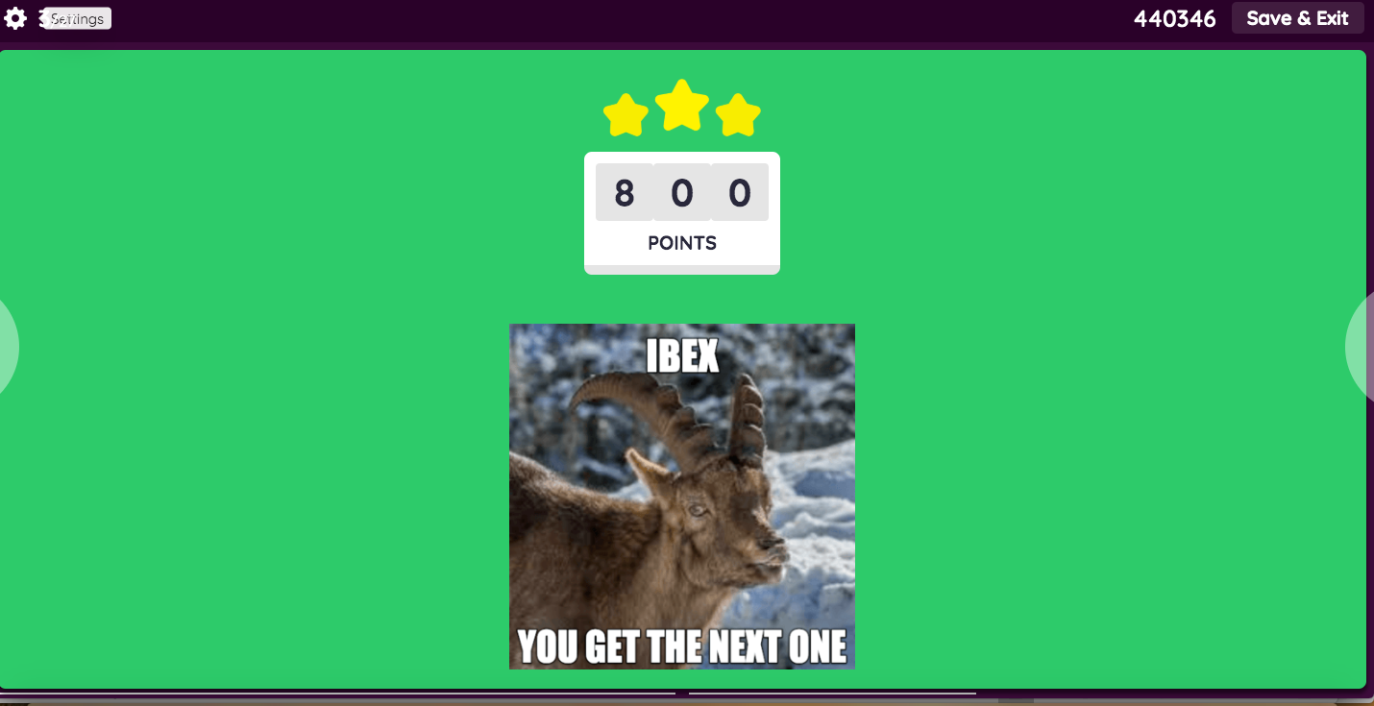
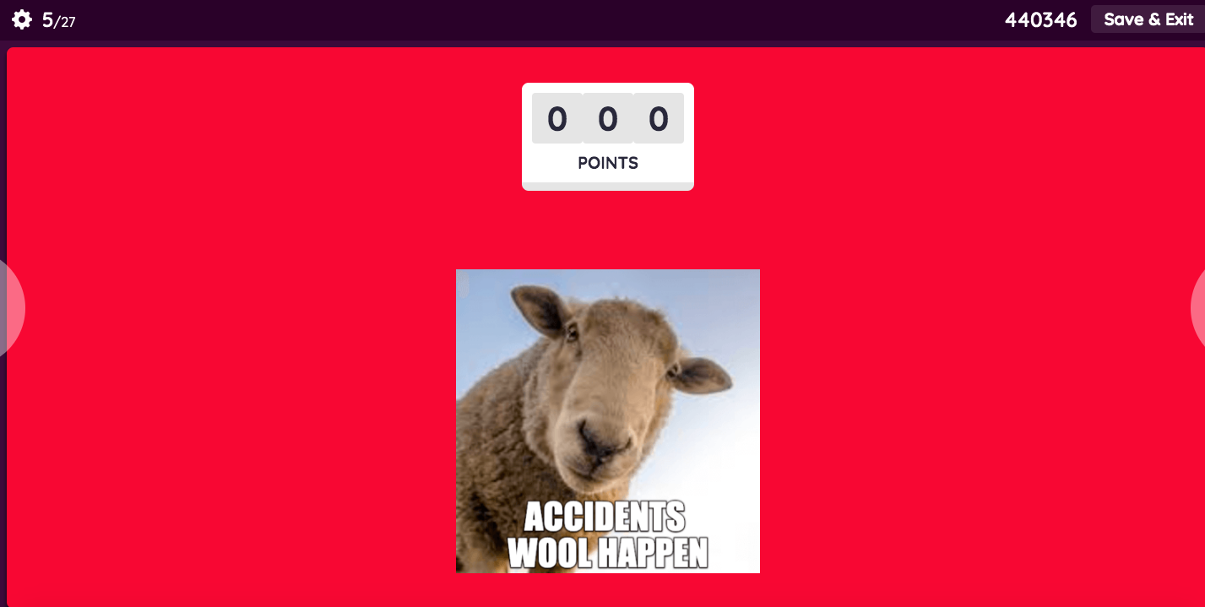
Quizizz
The question screen looks like this
I usually take the timer off but not always
If they get it correct they will get a supportive meme and points
If they get it incorrect they will get a different type of meme and 0 points

Slide 8
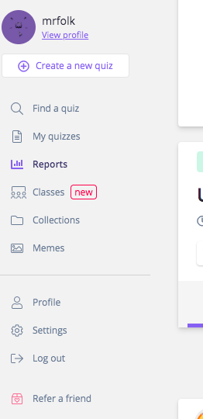
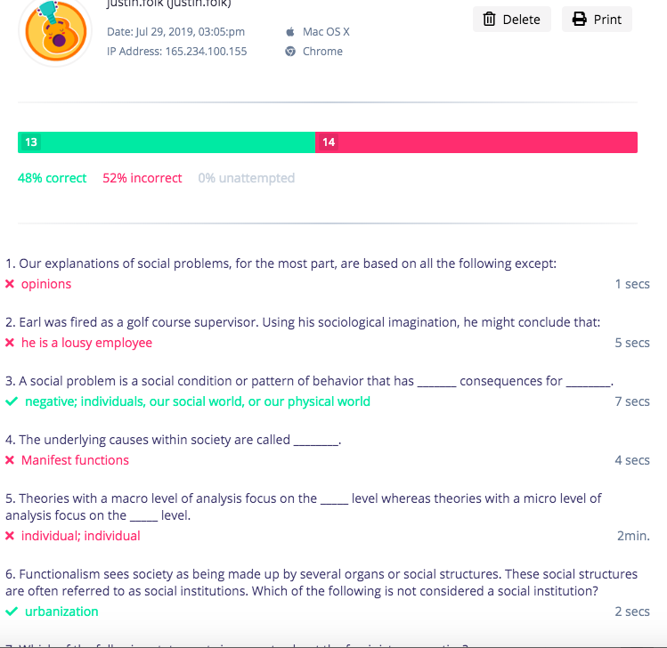
quizizz
After they finish they will get a screen with how they did
There is a flashcard option on the bottom as well
For me I look at the reports section on the left hand of the screen or receive an email when time has expired
I can see how students did and if I need to reteach
I can also email the parents if I so choose

Slide 9
Quizizz-Final Thoughts
Kids generally like Quizizz better than Kahoot because they can do them at their own pace, on their own device as many times as they would like.
They like the instant feedback and the meme’s
Junior high especially love Quizizz and ask to do them often
I have done them as reviews for tests or simple note checks
It is nice for me to get feedback too and its emailed right to me
I have also used it for pre-tests and when you talk about that material later in notes it comes back to their memory if they got it right or wrong.
I would say whatever way you want to use quizizz it could fall under all four categories of the SAMR system. It just depends how you want to use it.

