Slide 1
SAMR Assignment: ABC Mouse
By: Josephine Poitra

Slide 2
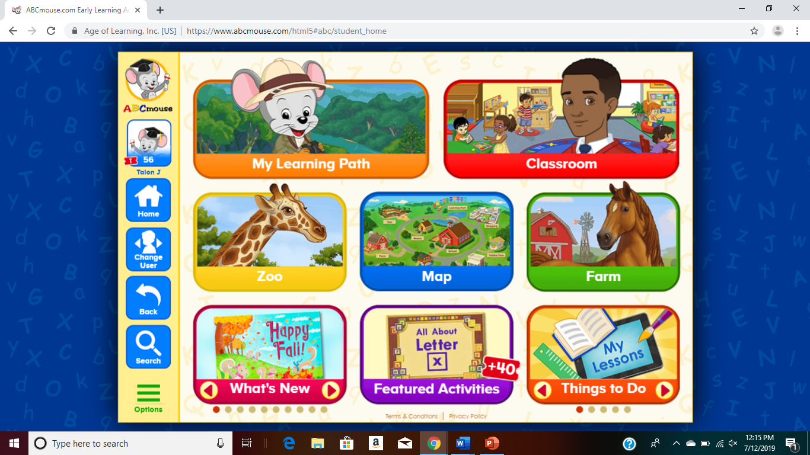
ABC Mouse is an App I use in my classroom every day. The App is intended for pre-K- 2nd grade. It is a paid App, but most administrators will pay for the App. The students love ABC Mouse, in my experience it was their favorite time of the day.

Slide 3
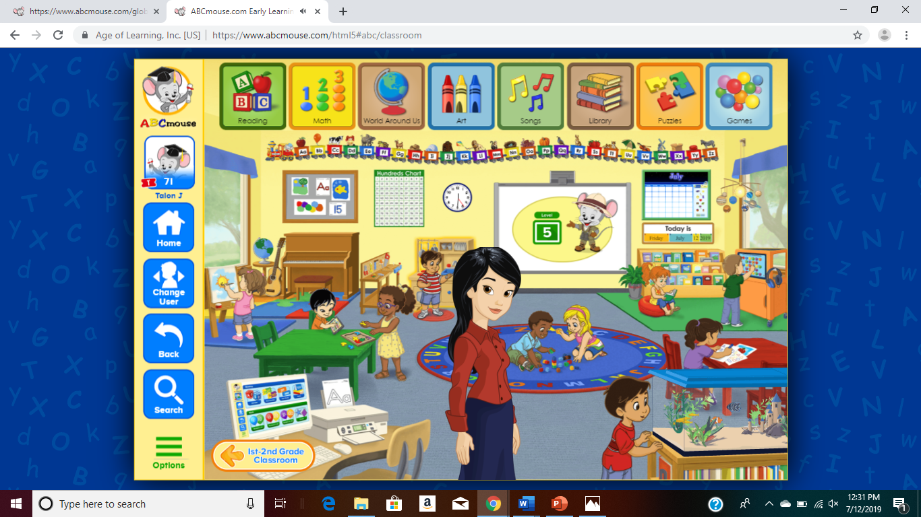
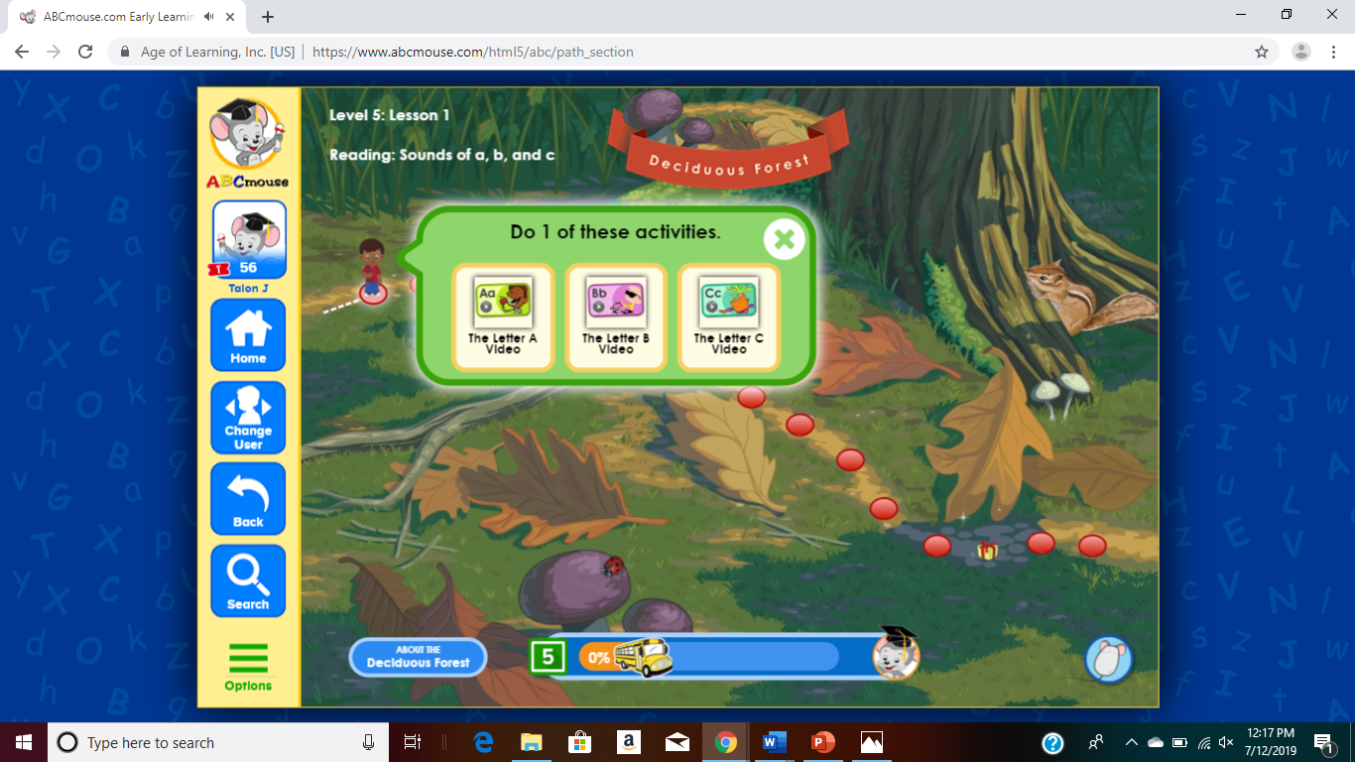
When the students go into the App, they can go into the classroom where they have the option to work on any of the subjects or they can go into their learning path where they gradually move into harder skills depending on how quick they pass each level. The teacher also has the option to assign lessons for each student to work on. The view you see at the bottom is the students view.
Classroom
My Learning Path

Slide 4
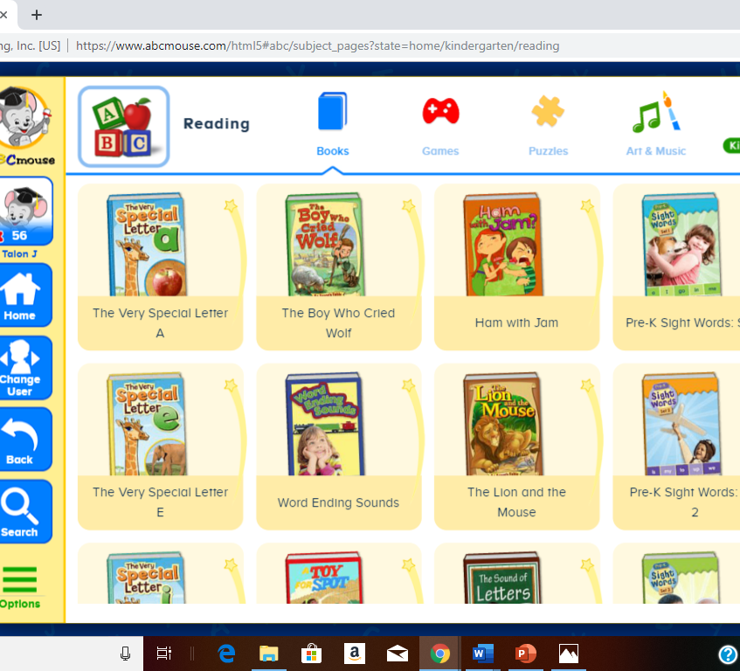
They also have the option to learn through music which I really encourage.
When choosing one of the subjects, the students have the option to play games, read rooks, or learn through art.

Slide 5
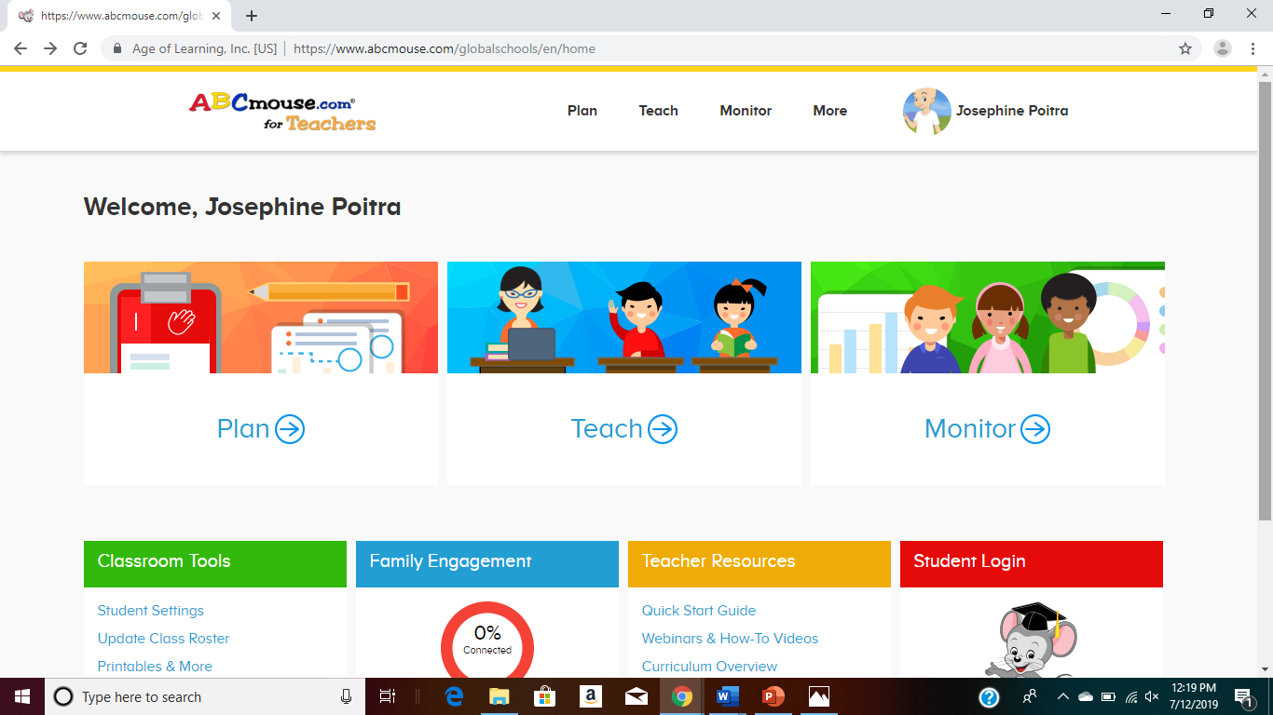
ABC mouse offers many different recourses. If you visit the teacher page, you can monitor the students' progress, assign tasks, and even add the students' parents so they can do assigned activities at home. ABC Mouse also offers printouts to do in the classroom as a helpful tool for teachers.

Slide 6
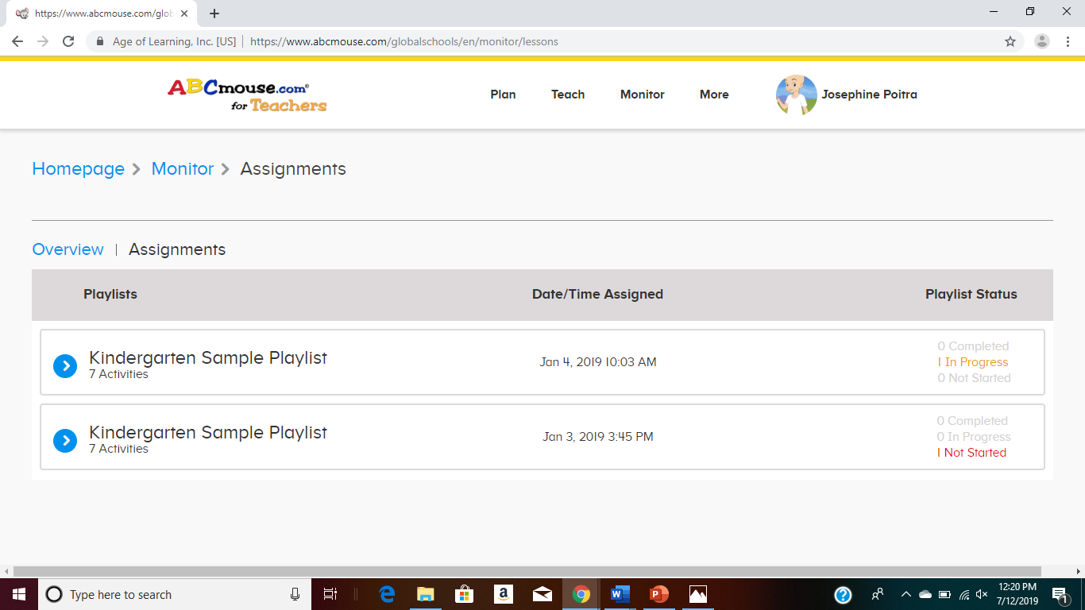
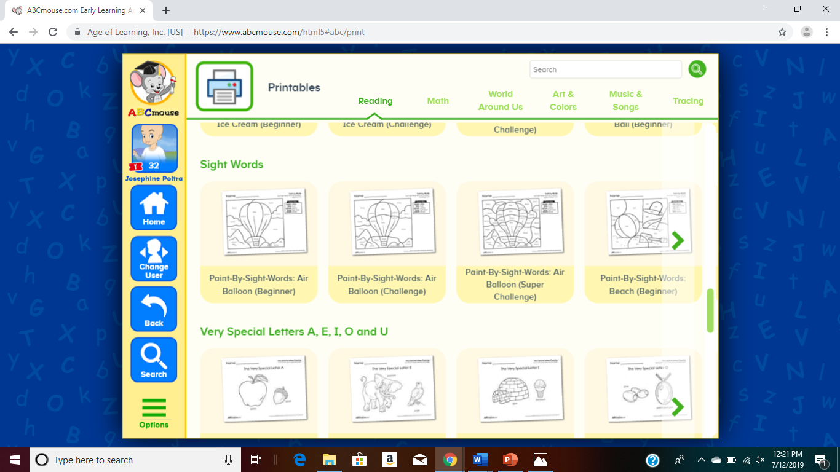

Slide 7
Reflection
ABC Mouse is something I use daily. The students love it and often ask to go on it during incentive times. On the SAMR model, ABC Mouse would fall under the redefinition portion. When using ABC Mouse the students do have the opportunity to learn new concepts depending on how quickly they are moving through the program. ABC Mouse is also a great resource for teachers and parents. I would highly recommend ABC Mouse to any Pre-K- 2nd grade teachers.

